Slide 1
L10 Rugged Tablet Platform Product Overview

Slide 2
L10 Platform Video Overview

Slide 3
The New Xplore L10 Rugged Tablet Platform by Zebra
With All of These Options, It Is Easy to Choose the Right Mobility Solution for Your Workers
The Xplore L10 rugged platform offers a variety of tablet configurations and a shared accessory ecosystem that sets a new standard in office, vehicle, and field-based computing.
Whether your mobile workers prefer a slate tablet, a tablet with a hard-handle and built-in barcode reader option, or a 2-in-1 laptop / tablet with a full-featured keyboard, the functional flexibility of the Xplore L10 ensures that your workers have the right computing tool for their job.

Slide 4
Agenda
Xplore Legacy
Xplore Brand Promise
L10-Series Overview
What’s New
Comparisons
Legacy Tablets
Compatibility / FAQs

Slide 5
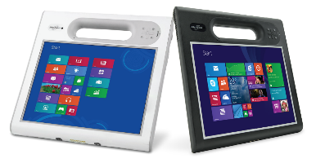
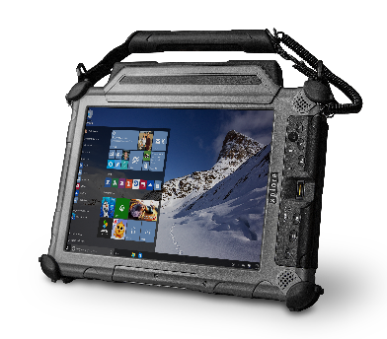
Xplore Legacy
F5m/C5m and the Xplore XC6 are great examples of the longevity and reliability Xplore believes is critical to customer success.
The iX104 was launched in 2002 and has continued to set the standard for ultra-rugged tablets.
The C5m was launched in 2007 and became the dominant rigid handle tablet in the market.
Throughout multiple generational updates the peripheral ecosystem has remained compatible helping to lower the total cost of ownership for customers.
Notes:
We’ve learned a lot and applied it to the new L10
You must continue to invest for a product to have this much success
This is the starting point not the end for the new L10, and its already amazing

Slide 6
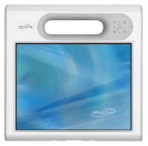
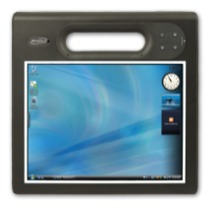
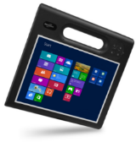
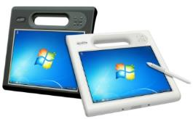
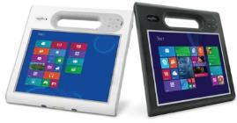
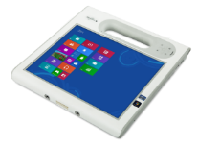
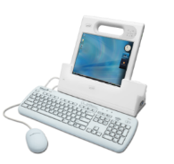
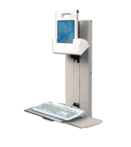
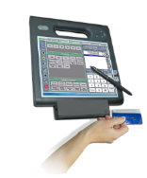
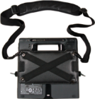
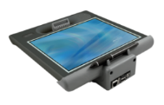
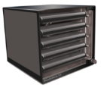
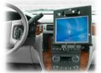
Xplore Legacy – C5/F5
2007
2009
2010
2012
2014
C5
F5
F5v / C5v
F5t / C5t (F5te/C5te)
F5m / C5m
First MCA (Mobile Clinical Assistant)
Disinfect-able – Doc Camera
Barcode - RFID
First Tablet with Gorilla Glass ViewAnywhere Outdoor Display
First with Intel vPro
SnapWorks Camera software
Long Range RFID Reader
Multi-bay battery charger
C1D2 HazLoc Protection
4G WWAN – 16 GB RAM
ACCESSORY ECOSYSTEM
Notes:
Ergonomics
Versatility

Slide 7
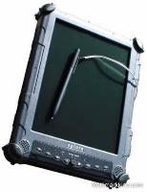
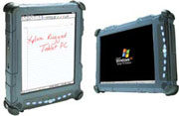
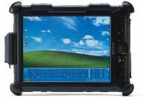
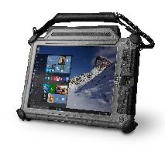
Xplore Legacy – XC6
2002
2004
2006
2007
2014
iX104-TPC
iX104R Renegade, iX104RD Dual Mode
& iX104C2
iX104C3
iX104C4
XC6 (DM, DML, DMCR, DMSR, M2)
First rugged Microsoft-compliant tablet PC to hit the market.
Latest Intel® mobile technology AllVue™ enhanced display Advanced wireless technology
Active digitizer pen and touch input for data entry
Best outdoor viewable display on the market
Five unique configurations
ACCESSORY ECOSYSTEM
Notes:
Rugged expertise
Displays for all conditions

Slide 8
Xplore Brand Promise
Xplore
is
Rugged
Shared accessory ecosystem over multiple generations is a core value proposition. Higher value
Xplore offers the ability to configure systems to meet the needs of end users. Faster
Xplore builds platforms that are designed to stand the test of time. Stronger
Low TCO is achieved through platform utility, stability, and reliability.
Notes:
Higher value through longevity and accessory compatibility across generations – Xplore lasts longer
L10 is the fastest rugged tablet and the most rugged 10”

Slide 9
Requirements for a Rugged Platform to PREVAIL
L10 Platform
High Performance
Ergonomic Design
Ample I/O
Versatility
Platform Longevity
Fully Rugged
Shared Accessories
Notes:
These are the guiding principles that Xplore followed to develop the L10 in order to make it the best rugged tablet platform on the market

Slide 10
Truly Versatile - Higher
Highly Mobile – Mission Critical – Harsh Environment – Information Workers
Typical Industries
Utilities – Line Workers
Telecommunications
Manufacturing / Industrial
Oil and Gas
Mining
Public Safety – Police/Fire/EMS
Construction
Military
One Size doesn’t always fit all
Workers have different preferences of form factor
Workers have different computing needs
Work happens in different environments
If your workers are mobile, their equipment needs to be rugged
Notes:
Give the right tool to the right worker

Slide 11
Best in class performance - Faster
L10 is the fastest rugged tablet on the market
Featuring 8th generation Intel Core i7 vPro with 16 GB RAM
PCIe SSDs
Available Apollo Lake Pentium is extremely economical rugged tablet option
$ per performance is unmatched
Up to 2.5 GHz Processor frequency
Comparable to Xplore B10 performance at Bobcat pricing level
WWAN – Cat 12
Up to 600% faster downloads, 300% faster uploads
Up to 600 Mbs download, 150 Mbs upload
Dual SIM

Slide 12
Xplore Rugged - Stronger
Mil-Std-810g
Not a certification, competitors take advantage of lack of consumer knowledge
Manufacturer determines drop height
Magnesium Frame
Harder than steel, lighter than aluminum
Thicker Gorilla Glass, Bezel around display, Rubber bumpers, Standard Display Protection Film
Consumer cases don’t protect against temp extremes or vibration, and break docking capability

Slide 13
Xplore Rugged - Stronger
Durability isn’t just a table stake for Xplore, it’s what we do – Learn More
Mil-Std-810g
Operating Temperature • Cold Start • Storage Temperature • Transit Drop • Vibration • Shock • Humidity • Natural Cycle Humidity • Water Proofness • Wind Driven Rain • Blowing Sand • Blowing Dust • Temperature Shock • Explosive Atmosphere • Contamination by Fluids • Altitude
Notes:
Go to our website, go get the full 800 page document, Xplore owns rugged
Some competitors claim built to pass 810g but don’t test, we have testing in house

Slide 14
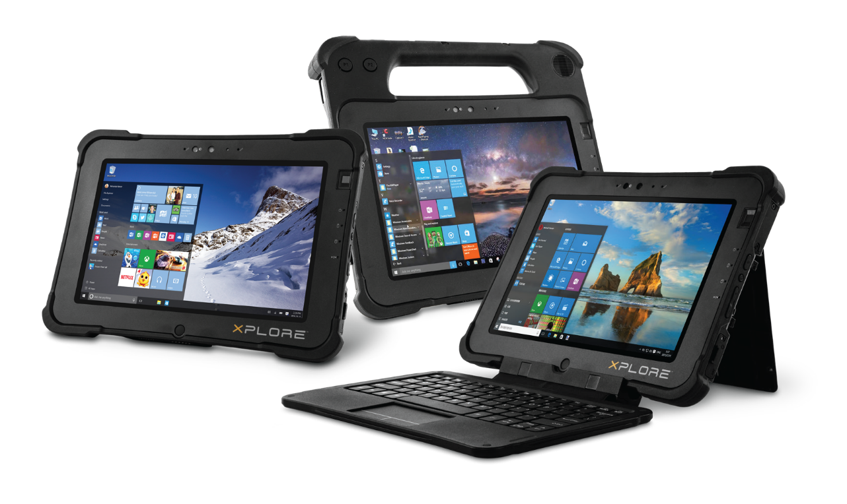
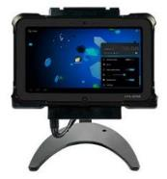
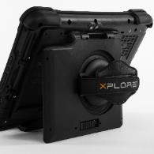
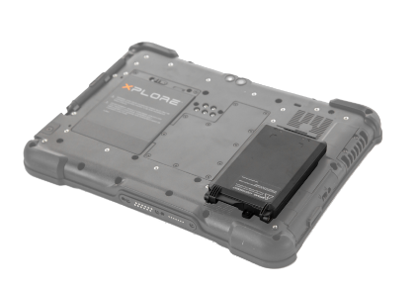
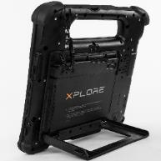
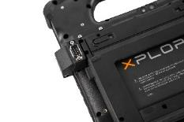
L10 Platform
A rugged and extremely powerful 10.1” tablet PC, ideal for mission-critical professionals, that is highly configurable to fit the needs of the worker and the work environment.
A full line of thoughtfully integrated accessories to ensure your workflow is optimized for efficiency

Slide 15
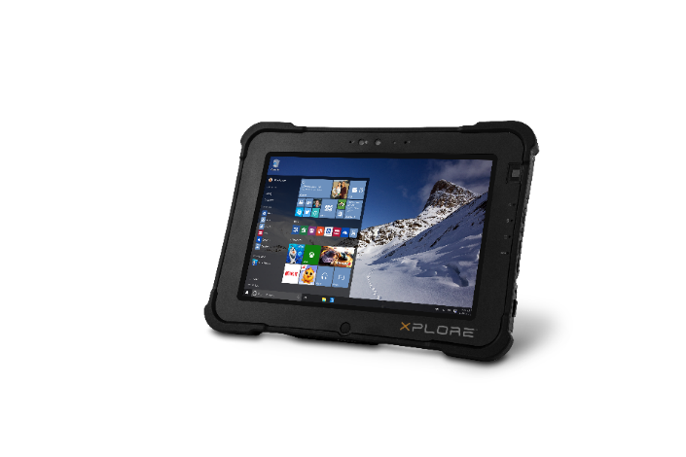
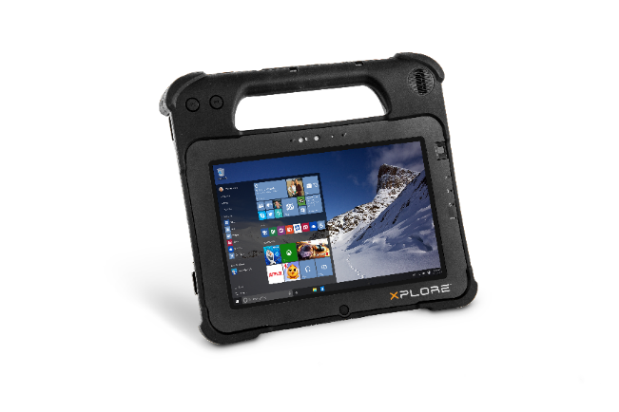
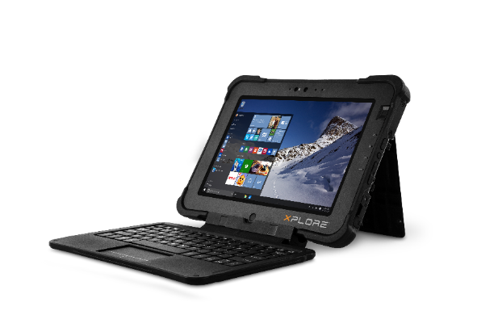
L10 is The Future of Rugged Computing
XSLATE
XPAD
XBOOK
Starting at $2199*
Starting at $2299*
Starting at $2399*
*Target US MSRP, Subject to Change
Notes:
FCS is Apollo lake, Slate early July, XPAD late July
Core FCS is August

Slide 16
Target Workers
XSLATE L10
XPAD L10
XBOOK L10
Field Worker - Utilities
Shop Floor – Manufacturing
Vehicle / Job Site
Field Worker - Utilities
Warehouse - Distribution
Data entry using Barcode
Manager / Supervisor
Frequent long form entry
2-in-1 users

Slide 17
L10 Product Tour

Slide 18
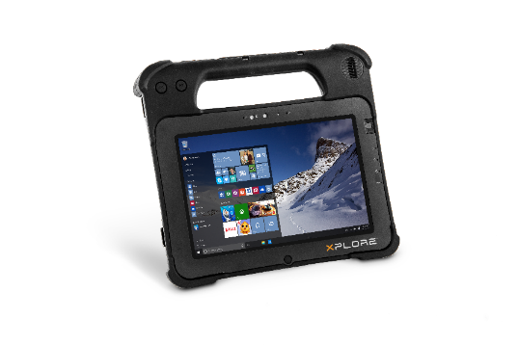
L10 Platform Options
L10 platform improves on Bobcat, B10, and C5/F5
L10 provides a lower cost alternative for XC6 users
L10 program has these major SKU choices
Handle, No Handle, or 2 in 1 Form Factor
Intel Pentium or Intel Core i5 / i7 vPro CPU
Standard 500 nit, View Anywhere 1000 nit, or View Anywhere 1000 nit with active digitizer display

Slide 19
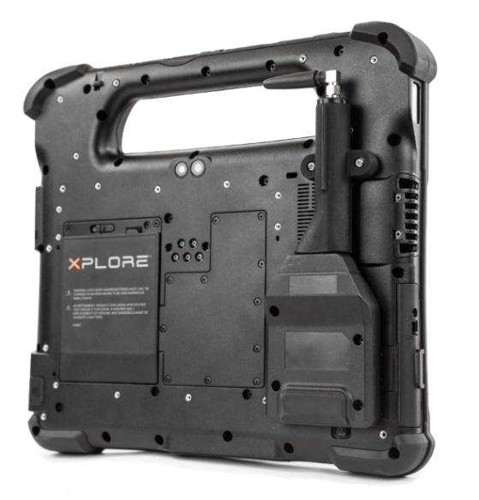
Optional Modules
L10 platform offers I/O expansion capability through optional modules
SmartCard / CAC Reader
Fully-enclosed
True RS232 Serial Port
Via HDMI port on side of unit
Not compatible with Pass Through Antenna
AEI / UHF long range RFID reader
Same module deployed with B10
HDMI-In
Internal board configured at POS
Notes:
NFC provides contactless SCR option
Expansion options now and capability for future modules

Slide 20
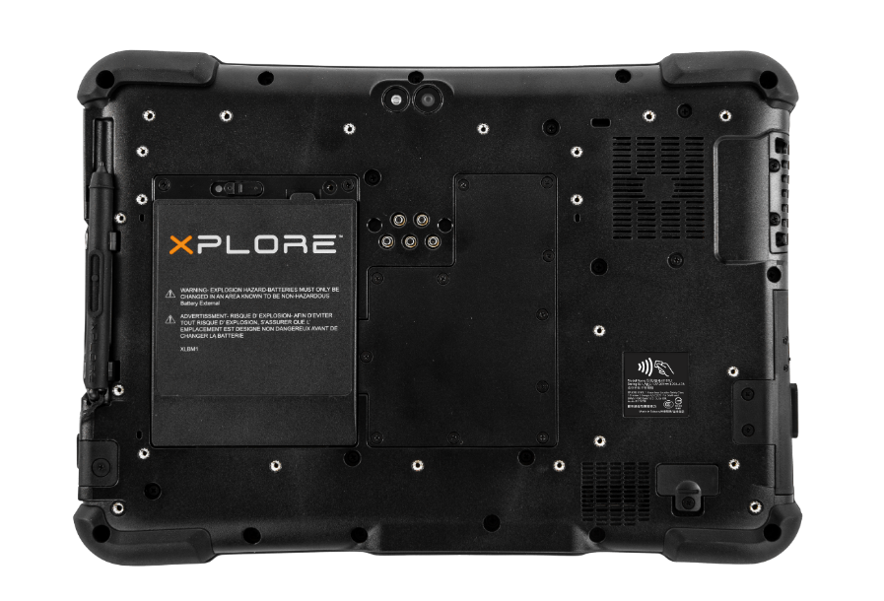
Ambient Light Sensor
2 MP Camera
Array Microphones
Flash / Torch
13 MP Camera
Fingerprint Reader
Power
Charging
SSD activity
Hard Shutoff button
NFC
Hot Swappable Battery
Pass Through Antenna
Expansion Module Port
Stylus Garage
Home Button
Notes:
13 MP camera is industry best
PTA is MIMO WWAN, WLAN with GPS all simultaneously
Short pen only on XSLATE, Soft handle can be added for long pens

Slide 21
DC In & RJ-45 Port
Exhaust Fan
Volume
Ctrl/Alt/Del
SD Card Slot
Power
USB Type C/Display Port
USB 3.0
HDMI-In / True Serial Port
USB 3.0
Audio Jack
Docking Port
Notes:
Exhaust fan is critical to maintain high performance in hot environments
RJ45 is key for interfacing with legacy equipment

Slide 22
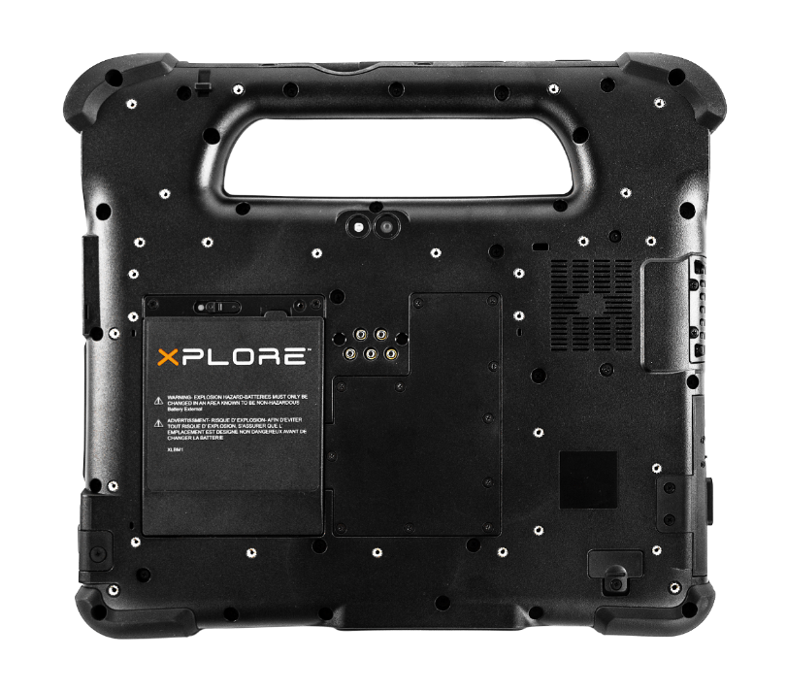
Programmable Function Buttons
Speaker
Kensington Lock Slot
Fan Intake
SSD / WWAN Access Panel
Notes:
Programmable buttons can be linked to users favorite software
Removable access panel is critical for high security environments where SSDs must be removed for a device to leave a facility (Govt., Manufacturing)
Kensington Lock slot provides additional physical security

Slide 23
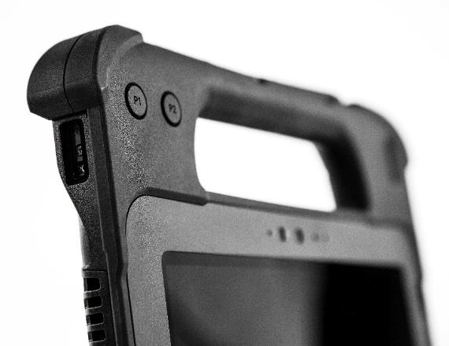
Barcode Scanner
Barcode Trigger
Long Stylus Garage
Notes:
Long pen storage
Ergonomic Barcode scanning with trigger on the handle

Slide 24
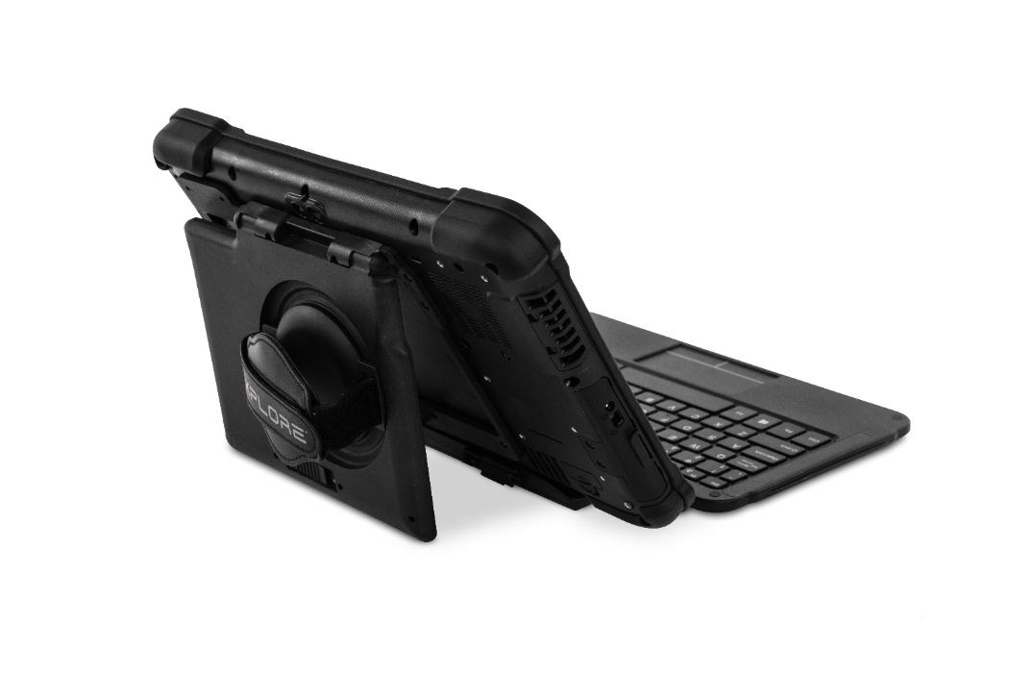
Kickstrap
Companion Keyboard
Notes:
Adjustable handstrap

Slide 25
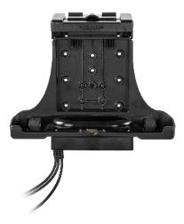
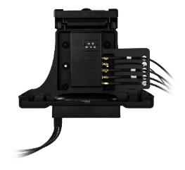
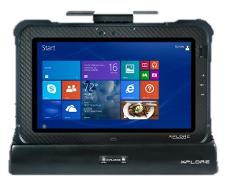
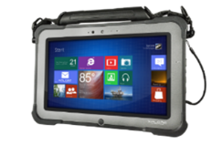
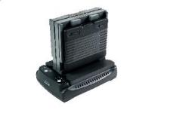
Key Accessories for L10
Vehicle Dock with and without PTA
Office Dock*
Top Handle
Industrial Dock
Smart Card / CAC Reader
Single Bay Battery Charger*
True Serial
Extended-life battery
Kickstrap
*Available post launch

Slide 26
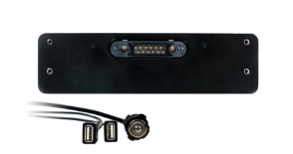
Dock port availability
Office Dock – Available January 2019
Kensington Lock
HDMI
VGA
(2) USB 3.0
RS232 Serial
Audio in
RJ-45 Ethernet
(2) USB 2.0
Audio out
Power
XDIM G3 (generation 3)
Powered USB 2.0
Power

Slide 27
Dock port availability
Dynadock - 4k Port replicator
Power
DVI-I video out
Display Port
HDMI
RJ-45 Ethernet
Security Lock Slot
(4) USB 2.0
USB 3.0 type B – connects Dynadock to computer Type B to type A cable provided

Slide 28
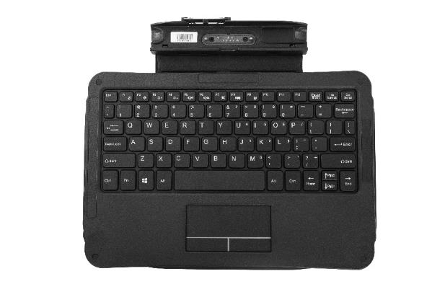
Key Accessories for L10
Companion keyboard has been improved
Improved hinge life
Tested to 10,000 cycles
US, UK, DE, ES, FR
Rugged Companion Keyboard in development (December ‘18 FCS)
Backlit keys
IP65 hard key scissor switch
IP68 rubber over scissor switch
Discrete mouse keys
Tear resistant hinge
US, UK, DE, ES, FR

Slide 29
L10 Key Features
 | XSLATE L10 | XPAD L10
OS | Windows 10 Pro – Launching Jun ‘18
Processors - RAM | Pentium – 4 or 8 GB, Core i5 – 8 or 16 GB, Core i7 – 16 GB
SSD | 64 GB – 1 TB (PCIe on Core i5 / i7)
Display | 10.1” WUXGA 1920 x 1200 2K Resolution, 500 or 1000 nit option, Glove/Wet Touch auto sensing, Active Digitizer option
Cameras | 2 MP Front, 13 MP Rear
Barcode Option | No | Yes
Pen | Capacitive or Active Pen option
I/O | 1 USB Type C, 2 USB 3.0, RJ45, NFC, Docking Connector, BCR (handle only) optional: True Serial, HDMI-In
Docks/Accessories | New Common Ecosystem
Durability / Safety | 6’ drop, IP65, IECEX cert, C1D2, ATEX Z2 – (Hazloc certs in October ‘18)
Security | TPM 2.0, Kensington Lock Slot, Integrated Fingerprint Reader, SmartCard
Battery | Hot Swappable Standard (10 hrs) and Long Life battery (27 hrs)
Weight | Starting from 2.5 lbs / 1.1 Kg

Slide 30
L10 Comparisons

Slide 31
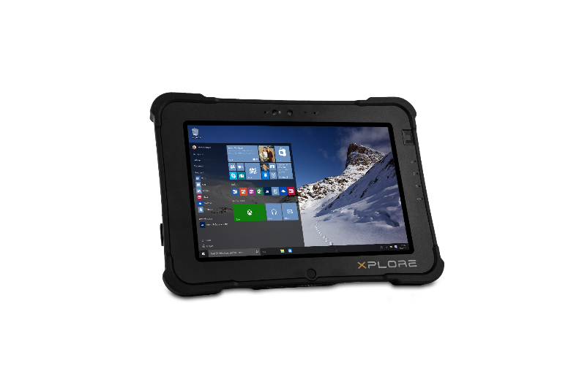
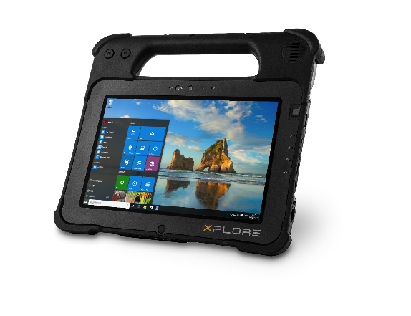
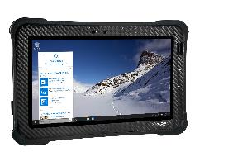
What’s New – Building on a Legacy
Higher – More Versatile
Multiple form factors
More Standard Ports
More Expansion Modules
Multiple Display Configurations
Faster – Better Performance
8th Generation Intel Core Series CPUs
Apollo Lake Pentium
13 MP rear camera
Windows 10 Pro
600% faster downloads, 300% faster uploads
Antenna Pass-through (WWAN, WLAN, & GPS)
Optional extended life battery
Stronger – More Rugged
IP65, 6 ft. drop to plywood
Auto Sensing Glove / Wet Touch
Wide Temperature Range
ATEX and IECEX SKUs
Notes:
Higher value through versatility – get the right product to the right worker
Xplore owns rugged
Fastest and most economical, better camera, better wireless

Slide 32
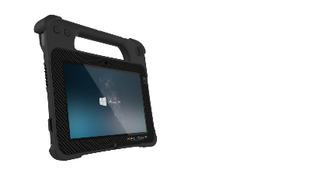
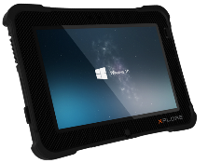
What’s New
L10
F5m/C5m
IP65, 6 ft. drop to plywood
Starting from 2.8 lbs
1000 Nit ViewAnywhere display, 2k (1920 x 1200); 500 Nit Standard Display
Autosense glove and wet touch
Up to 1 TB PCIe Storage
Micro SDHC port
13 MP rear camera
Windows 10 Pro
(2) USB 3.0, (1) USB type C
Optional True Serial Port, or HDMI-IN
Antenna Pass-through (MIMO WWAN, WLAN, & GPS)
Cat 12 WWAN: up to 600% faster downloads, 300% faster uploads
Optional extended life battery
ATEX and IECEX SKUs
IP54, 4 ft. drop to plywood
3.3 lbs
400 Nit display, XGA (1024 x 768)
Up to 256 GB Storage
8 MP rear camera
Windows Pro OS
(1) USB 3.0

Slide 33
What’s the Same
F5m/C5m & L10
Rigid Handle (optional on L10)
Configurability
CPU options
Storage / Memory options
Expansion options
Hot Swappable Battery
Battery status indicator
Ergonomic Barcode Reader
Active Digitizer & Pen (optional on L10)
Noise canceling microphones
Programmable buttons
HazLoc ready
3 year warranty standard

Slide 34
L10 comparison to F5m/C5m
Display | • 10.1" 1920 x 1200, 1000 NIT and 500 NIT option | • 10.4" 1024 x 768, 500 Nit, Standard and VAD option
Processor | • Apollo Lake Pentium N4200, Kaby Lake Core i5 vPro 8350U, Kaby Lake Core i7 vPro 8650U | • i3 5005U, i5 5200U, i7 vPro 5600U
Security | • TPM 2.0, vPro, CAC/Smart Card, Kensington Lock Slot, Fingerprint reader, Locking Mobile Dock | • TPM 2.0, NIST BIOS, Absolute, Fingerprint Reader, Smart Card
Optional Features | • CAC/SmartCard Reader, Barcode Reader, Long Life Battery, Rigid Handle, True Serial, HDMI-In, UHF RFID | • CAC/Smart Card, Barcode Scanner, Fingerprint reader
Durability and Rugged Features | • IP65 • Mil-STD-810G, 6’ drop | • IP54 • Mil-STD 810g, 4’ drop
Starting Price | $2,199 | $2,549 MSRP

Slide 35
L10 comparison to F5m/C5m Summary
L10 builds on the learnings from 10 years of successful F5m/C5m platform deployments
The Rigid handle enables a confident grip
Point and shoot Barcoding
More ports for I/O included
Higher drop spec and ingress rating
Higher resolution, brighter display
Improved imaging capability
Lighter weight and higher battery life
Cat 12 WWAN - Up to 600% faster downloads, 300% uploads – Dual SIM
Pass-Through Antenna, MIMO WWAN & WLAN, GPS
Full suite of workflow enhancing accessories
Interoperability with accessories, decreases TCO

Slide 36
L10 comparison to B10/Bobcat
Display | • 10.1" 1920 x 1200, 1000 Nit and 500 Nit option | • 10.1" 1366 x 768, 500 Nit
Processor | • Apollo Lake Pentium N4200, Kaby Lake Core i5 vPro 8350U, Kaby Lake Core i7 vPro 8650U | • Atom E3845, Core i5-5350U
Security | • TPM 2.0, vPro, Smart Card, Kensington Lock, Fingerprint reader, Locking Mobile Dock | • TPM 2.0, Kensington Lock, Fingerprint Reader, CAC/Smart Card
Optional Features | • CAC/SmartCard Reader, Barcode Reader, Long Life Battery, Rigid Handle, UHF RFID (AEI), True Serial, HDMI-In | • CAC/Smart Card, Barcode Scanner, Fingerprint reader, NFC, HDMI-In, Long Life Battery
Durability and Rugged Features | • IP65 • Mil-STD-810G, 6’ drop | • IP65 • Mil-STD 810g, 5’ drop
Starting Price | $2,199 | $2,499

Slide 37
L10 comparison to B10 / Bobcat Summary
The XSLATE version of L10 will serve as a generational upgrade to the B10/Bobcat platform
New generation of high performance CPUs
Higher drop spec
Higher resolution, brighter display
Improved imaging capabilities
Auto-sensing glove and wet touch
Cat 12 WWAN - Up to 600% faster downloads, 300% uploads – Dual SIM
Pass-Through Antenna, MIMO WWAN & WLAN, GPS
Full suite of workflow enhancing accessories
Interoperability with accessories, decreases TCO

Slide 38
L10 comparison to XC6
Display | · 10.1" 1920 x 1200, 1000 NIT and 500 NIT option | · 10.4" 1024 x 768, 1300 Nit
Processor | · Apollo Lake Pentium N4200, Kaby Lake Core i5 vPro 8350U, Kaby Lake Core i7 vPro 8650U | · i5-4300U, i7-4650U
Security | · TPM 2.0, vPro, Smart Card, Kensington Lock, Fingerprint reader, Locking Mobile Dock | · TPM 1.2, Absolute DDS, Kensington Lock, Fingerprint Reader, Smart Card, vPro, AMT 9.5
Optional Features | · CAC/SmartCard Reader, Barcode Reader, Long Life Battery, Rigid Handle, UHF RFID, True Serial, HDMI-In | · Dual SSDs, Serial, CAC/Smart Card
Durability and Rugged Features | · IP65 · Mil-STD-810G, 6’ drop | · IP67 · Mil-STD 810g, 7’ drop
Starting Price | $2,199 | $3,648 MSRP

Slide 39
L10 comparison to XC6 Summary
L10 is a response to the market demands for the XC6 platform, an extremely rugged tablet platform at a lower cost.
Alternative to Ultra rugged: IP65 & 6’ drop rating
Auto-sensing glove and wet touch
Lighter weight and longer battery life
Hazardous location ready, C1D2
1000 Nit ViewAnywhere display
Cat 12 WWAN - Up to 600% faster downloads, 300% uploads – Dual SIM
Ample ports for I/O included
Improved imaging capabilities
Full suite of workflow enhancing accessories
Interoperability with accessories, decreases TCO

Slide 41
L10 Backup Slides

Slide 42
 |  |  |  | L10 COMPATIBILITY MATRIX
 | Tablet form factor exclusions |  |  |  | Accessory Exclusions
 | ATEX SKU Any | Lynx Tablet "xSlate" | Lynx Hard Handle "xPad" | Main Battery 36 Whr | Extended Battery 98 Whr | Kickstand Battery Bracket | Kickstrap | True Serial Adapter | Keyboard | Vehicle & Office Dock | Vehicle Dock Antenna Pass Through | CAC Module | Top Handle | AEI/CLS Module | Digitizer Stylus, Long | Digitizer Stylus, short | E-Pen, long
Main Battery 36 Whr | Y | Y | Y |  | N | Y | Y | Y, Note 4 | Y, Note 2,3 | Y | Y, Note 7 | Y | Y | Y | Y, Note 6 | Y, Note 6 | Y
Extended Battery 98 Whr | N | Y, Note 1 | Y, Note 1 |  |  | Y | N | Y, Note 4 | Y, Note 2,3 | Y | N | Y | Y | Y | Y, Note 6 | Y, Note 6 | Y
Kickstand Battery Bracket | N | Y | Y |  |  |  | N | Y, Note 4 screw length L10.8, R8.5 | Y, Note 2,3 | Y | N | Y | Y screw length L10.8, R14.3 | Y | Y, Note 6 | Y, Note 6 | Y
Kickstrap | N | Y | Y |  |  |  |  | Y, Note 4 screw length L10.8, R8.5 | Y, Note 2,3 | Y | N | Y | Y screw length L10.8, R14.3 | Y | Y, Note 6 | Y, Note 6 | Y
True Serial Adapter | N | Y | Y |  |  |  |  |  | Y, Note 2,3 | Y | N | Y | Y screw length L10.8, R16.3 | Y | Y, Note 6 | N | Y
Keyboard | N | Y, Note 2,3 | Y, Note 2,3 |  | Duplicate Mirrored Matrix |  |  |  |  | Y, Note 3 | Y, Note 3 | Y | Y | Y | Y, Note 6 | Y, Note 6 | Y
Vehicle & Office Dock | N | Y | Y |  |  |  |  |  |  |  |  | Y | Y | Y | Y, Note 6 | Y, Note 6 | Y
Vehicle Dock Antenna Pass Through | N | Y, Note 7 | Y, Note 7 |  |  |  |  |  |  |  |  | Y | Y | Y | Y, Note 6 | Y, Note 6 | Y
AEI/CLS Module | N | Y | Y |  |  |  |  |  |  |  |  |  | N screw length L10.8, R12.7
CAC Module | N | Y | Y |  |  |  |  |  |  |  |  |  | Y | N | Y, Note 6 | Y, Note 6 | Y
Top Handle | N | Y | N |  |  |  |  |  |  |  |  |  |  |  | Y, Note 6 | N | Y
Digitizer Stylus, Long | Tablet no hard handle yes | Y, Note 5 | Y
Digitizer Stylus, short | Tablet yes, hard handle no | Y | N
E-Pen, long | N | Y, Note 5 | Y
Notes:
1. Must have Kickstand Battery Bracket for Extended battery
2. Must have Kickstand Battery Bracket or Kickstrap with Keyboard
3. Must remove keyboard before docking
4. Must have Kickstand Battery Bracket or Kickstrap with true serial adapter
5. Must have Top Handle or xPad to stow the long stylus or E-pen
6. Must have Wacom digitizer in tablet
7. Must have antenna pass through enabled tablet

Slide 43
Common Compatibility Issues
Pass Through antenna not compatible with:
Extended battery bracket, Kickstand
KickStrap
True Serial module
Extended battery
XBOOK includes the KickStrap
No KickStands
No extended battery option
No pass through antenna
XSLATE, XBOOK have a short pen garage only
Soft handle required for long pens

Slide 44
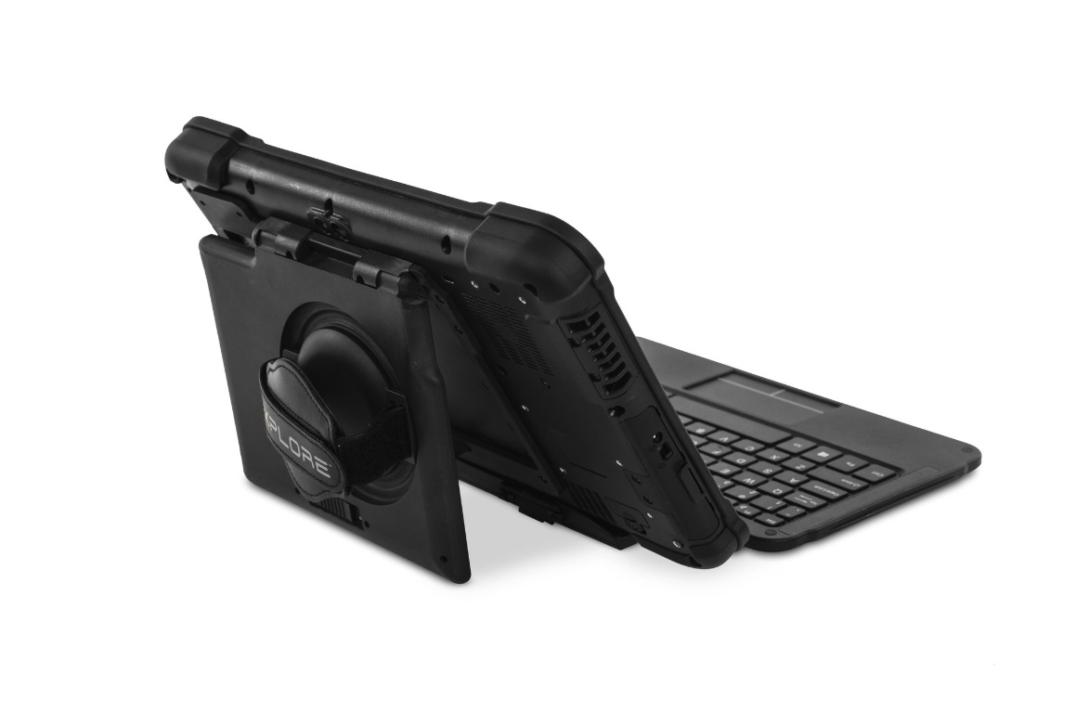
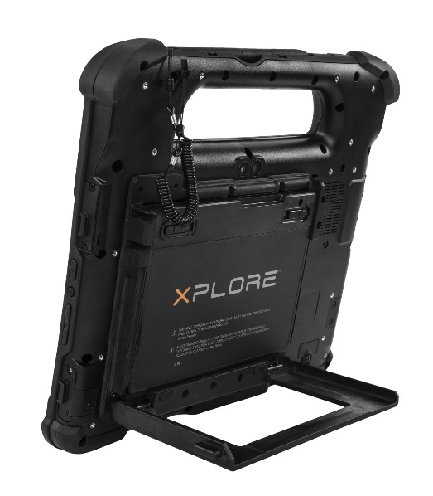
Pass-through antenna compatibility conflicts
XBOOK not compatible with:
Extended battery
Kickstand
Pass through antenna
Extended Battery not compatible with:
KickStrap
Pass Through Antenna
Serial Module not compatible with:
Pass Through Antenna
Serial must have either:
Kickstand or KickStrap

Slide 45
Common Compatibility Issues
Active digitizer is only available on the 1000 nit View Anywhere display
Pen type is tied to the display and form factor
XSLATE / XBOOK 500 & 1000 nit non active displays ship with short passive pen
XSLATE / XBOOK active 1000 nit display ships with short active pen
XPAD 500 and 1000 nit not active display ships with long E-Pen
XPAD active 1000 nit display ships with long active pen
xDIM G3
Docking interface module generation 3
Same form factor as xDIM G2
Enables ports to be powered through tablet power, i.e. ports function after dock power is lost
Forward / backward compatible

Slide 46
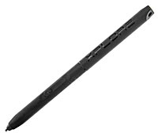
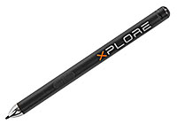
Pens
440036 - Long Active Pen – Wacom
XPAD with active View Anywhere 1000nit
Soft handle with Active Pen
440043 - Long E-Pen
XPAD with 500 or 1000 nit non-active display
Soft handle with E-Pen
440037 - Short Active Pen – Wacom
XSLATE or XBOOK with active View Anywhere 1000 nit
440007 - Short Passive Pen
XSLATE or XBOOK with 500 or 1000 nit non-active display

Slide 47
Accessories
Xplore PN | Xplore Part Description | US MSRP
300139 | Dock, L10 Vehicle Dock - Cradle | $199.99
300140 | Dock, xDIM Module G3, Cigarette Lighter Adapter | $199.99
300143 | Dock, L10 Vehicle Dock - Cradle, DIM, Cigarette Lighter Adapter | $399.99
300149 | Dock, L10 Industrial Dock, NA PWR | $349.99
410052 | Carry, L10 Soft Handle w/Coiled tether, without Pen | $49.99
410055 | Carry, L10 KickStrap kit | $99.99
410056 | Carry, L10 Kickstand Extended Battery Bracket kit | $99.99
410057 | Carry, L10 Shoulder Strap | $29.99
410058 | Carry, L10 Carry Case - XSLATE | $159.99
410059 | Carry, L10 Carry Case - XPAD | $159.99
410061 | Carry, L10 Soft Handle Kit – Active Stylus | $99.99
410062 | Carry, L10 Soft Handle Kit - ePen | $99.99
420084 | Keyboard, L10 Companion Keyboard – US | $169.99
440042 | Stylus, L10 Active Stylus tip field replacement kit | $4.99
450148 | Power, Battery, L10 36 Whr Standard Battery | $149.99
450149 | Power, L10 Extended life battery, 98 WHr | $199.99
450154 | Power, L10 Spare Adapter for Tablet | $34.99
L101STD | Warranty, L10 4 Year Standard Warranty, 3-Yr Std extended to 4-Yr Std | $149.00
L102STD | Warranty, L10 5 Year Standard Warranty, 3-Yr Std extended to 5-Yr Std | $299.00
L1036W2Y | Battery, L10 Standard Battery Warranty 36 WHr, 2-YR | $149.00
L1036W3Y | Battery, L10 Standard Battery Warranty 36 WHr, 3-YR | $299.00
L1036W4Y | Battery, L10 Standard Battery Warranty 36 WHr, 4-YR | $449.00
L1036W5Y | Battery, L10 Standard Battery Warranty 36 WHr, 5-YR | $599.00
L103XDEF | Warranty, L10 3 Yr Xdefend, 3-Yr Std extended to 3-Yr xDefend | $349.00
L104XDEF | Warranty, L10 4 Yr Xdefend, 3-Yr Std extended to 4-Yr xDefend | $599.00
L1098W2Y | Battery, L10 Extended Battery Warranty 98 WHr, 2-YR | $199.00
L105XDEF | Warranty, L10 5 Year xDefend Coverage, 3-Yr Std extended to 5-Yr xDefend | $775.00
L1098W3Y | Battery, L10 Extended Battery Warranty 98 WHr, 3-YR | $399.00
L1098W4Y | Battery, L10 Extended Battery Warranty 98 WHr, 4-YR | $599.00
L1098W5Y | Battery, L10 Extended Battery Warranty 98 WHr, 5-YR | $799.00

Slide 48
Common Questions - processors
What are the processor options?
In layman’s terms:
Apollo Lake Pentium
Kaby Lake Refresh 8th Gen Core i5
Kaby Lake Refresh 8th Gen Core i5 vPro
Kaby Lake Refresh 8th Gen Core i7 vPro
Technical description
8th Generation Intel® Core™ i7 vPro™ Processor – 8650U (16 GB RAM) - LPDDR3, 1.90 GHz with turbo frequency to 4.20 GHz
8th Generation Intel® Core™ i5 vPro™ Processor – 8350U (16 GB RAM) - LPDDR3, 1.70 GHz with turbo frequency to 3.60 GHz
8th Generation Intel® Core™ i5 Processor – 8250U – (8 GB RAM) - LPDDR3, 1.60 GHz with turbo frequency to 3.40 GHz
Intel® Pentium® processor N4200 – (4 or 8 GB RAM) - LPDDR4, 1.10 GHz with turbo frequency to 2.50 GHz

Slide 49
Common Questions - wireless
What is Cat 12 for WWAN?
Cat 12 enables the combination of up to 3 bands of LTE data, enabling up to 600 Mbs download speeds and 150 MBs upload speeds
What wireless carriers are certified on L10?
AT&T and Verizon are certified
Sprint is not
Wi-Fi
L10 is rated 802.11 AC for WLAN communications
High throughput data transfer on the 5 GHz band
Improvements over older specs include wider channels, more spatial streams, higher order modulation, MIMO enabled

Slide 50
Common Questions – display technology
L10 Display options
All display options are:
10.1” 2K resolution (1920 x 1200), 16:10 ratio
Auto-sensing glove and wet touch
Corning Gorilla Glass 3
Thicker layer versus consumer devices
800:1 Contrast ratio
89^{ᵒ} viewing angle
Standard – 500 nit, capacitive
View Anywhere – 1000 nit, capacitive
Supports night vision mode
Active View Anywhere – 1000 nit, capacitive with an active Wacom digitizer
Supports night vision mode

Slide 51
Common Questions – GPS
Two GPS options are available
u-Blox Discrete GPS - or – Sierra Wireless Mobile Broadband + GNSS
Choices are mutually exclusive
Summary:
Xplore provides two options for GPS capability to ensure users have a choice that fits the needs of their workflow.
Location dependencies:
For use in open areas, the performance will be very similar between options. In areas where the horizon is blocked by geographic features or large structures the Sierra Wireless GPS is likely to perform better due to the ability to acquire more satellites from overhead.
The discrete u-blox GPS device supports Satellite Based Augmentation Systems (SBAS) to increase accuracy, including the Wide Area Augmentation System (WAAS) for increased accuracy throughout North America and Hawaii, the European Geostationary Navigation Overlay Service (EGNOS) for increased accuracy throughout Europe, and the Multi-functional Satellite Augmentation System (MSAS) for increased accuracy in Japan. In areas where the augmentation systems are not available, the u-blox GPS device will provide an accuracy of < 2m (CEP 50%).
Parameter | NaviSys Technology u-blox® GPS with SBAS | Sierra Wireless EM75xx Mobile Broadband + GNSS
Satellites | GPS + GLONASS with SBAS (WAAS, EGNOS, and MSAS) | GPS + GLONASS + Galileo + Beidou
Channels | 56 channels | 30 channels
Protocol | NMEA 0183 V2.3 (compatible with V3.0) | NMEA 0183 V3.0
Acquisition time (hot / warm / cold) | 1sec / 28sec / 30sec | 1sec / 29sec / 32sec
Accuracy (CEP 50%) (h / a / v) | < 2m (SBAS) / --- / < 0.1m/s | < 2m / < 4m / < 0.2m/s
Sensitivity (tracking / acquisition) | -161dBm / -147dBm | -160dBm / -145dBm
CEP : circular error probable
h/a/v : horizontal / altitude / velocity
SBAS : Satellite Based Augmentation System

Slide 52
L10 UHF RFID (AEI) Reader
The UHF RFID Reader is a mobile solution designed specifically for Xplore L10 rugged tablets. This solution delivers the mobility and productivity of a handheld RFID Reader device with the flexibility and functionality of a powerful computer. The UHF RFID (AEI) reader meets safe distance requirements for rail while adding mobility advantages over fixed readers.
Key Features:
Adds UHF RFID functionality to the Xplore L10 rugged tablet
Lightweight
No external power supply required
APIs available for custom software development
Specifications:
Read range up to 3m (Tag Dependent)
Max Read Rate: 50 tags / second
Operating Temperature: -20°C to 60 °C / -4 °F to 140 °F
Storage Temperature: -30 °C to 70 °C / -22 °F to 158 °F
Device peak power consumption: 4w
RF max power: .05w
Regulatory:
Regulatory Pre-configured for the following regions:
FCC (NA, SA) 902-928 MHz
ETSI (EU, India) 865.6-867.6 MHz
TRAI (Inida) 865-867 MHz
KCC (Korea) 917-920.8 MHz
ACMA (Australia) 920-926 MHz
SRRC-MII (P.R.China) 920-925 MHz
MIC (Japan) 916.8-923.4 MHz
‘Open’ (Customizable channel plan; 865-868 MHz and 902-928 MHz)

