Slide 1
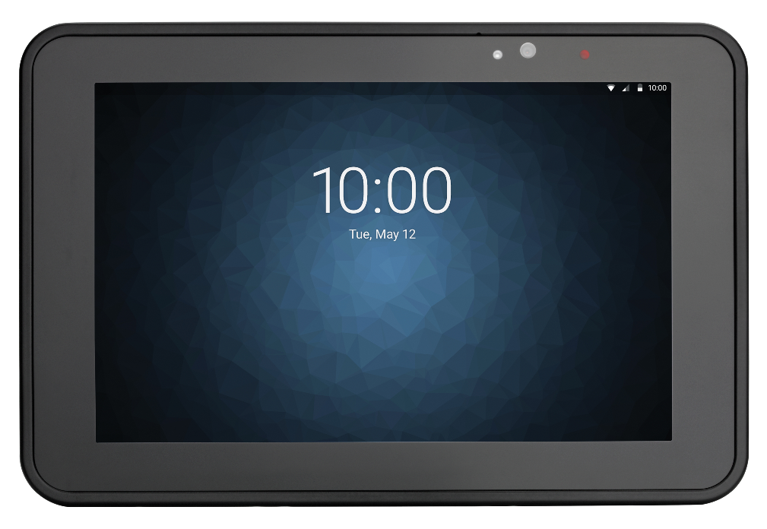
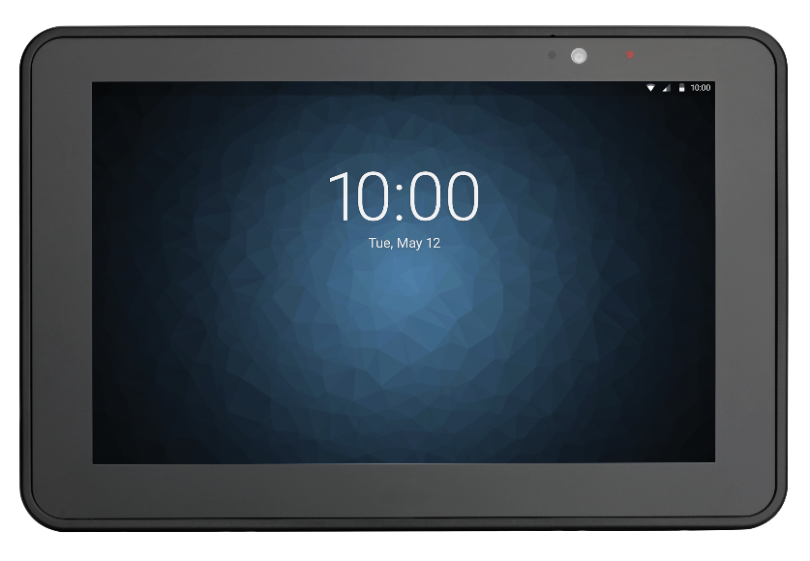
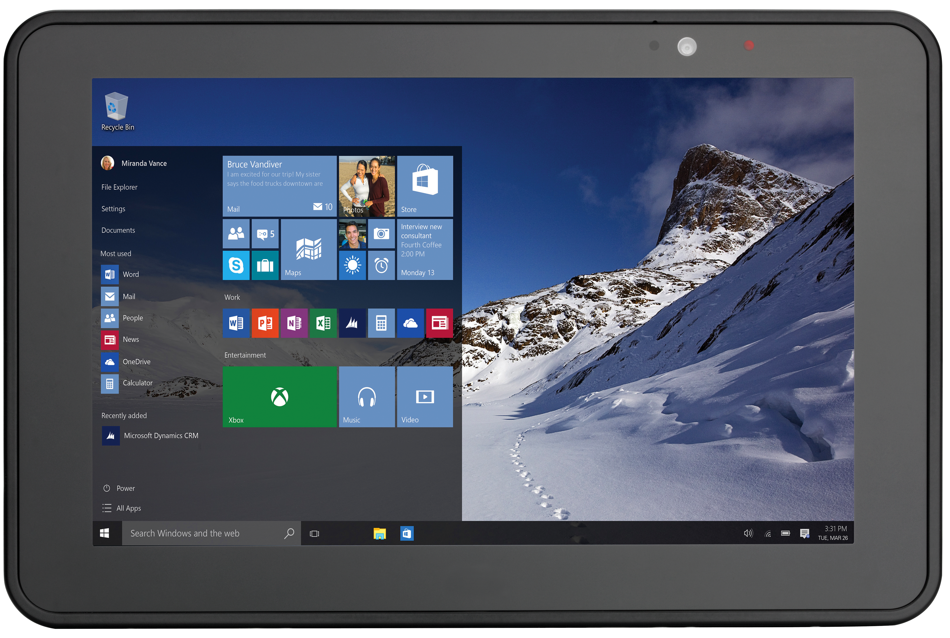
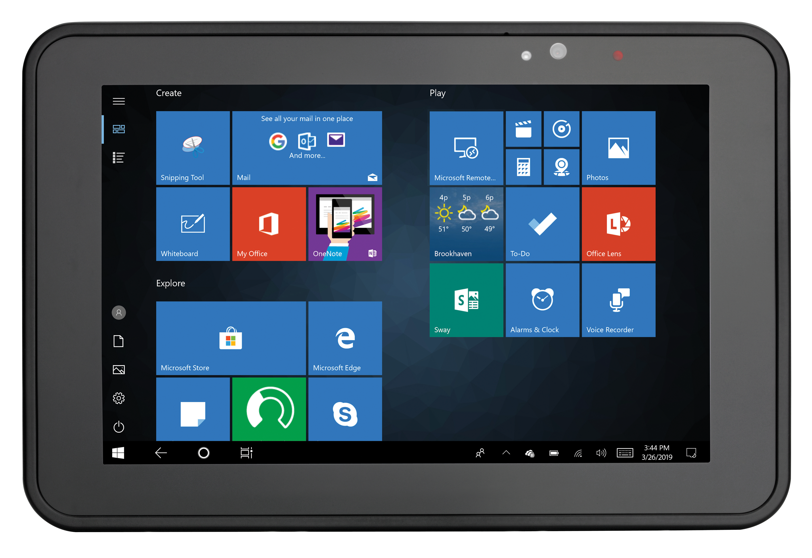
ET51/56 Android and Windows Rugged Enterprise Tablets

Slide 2
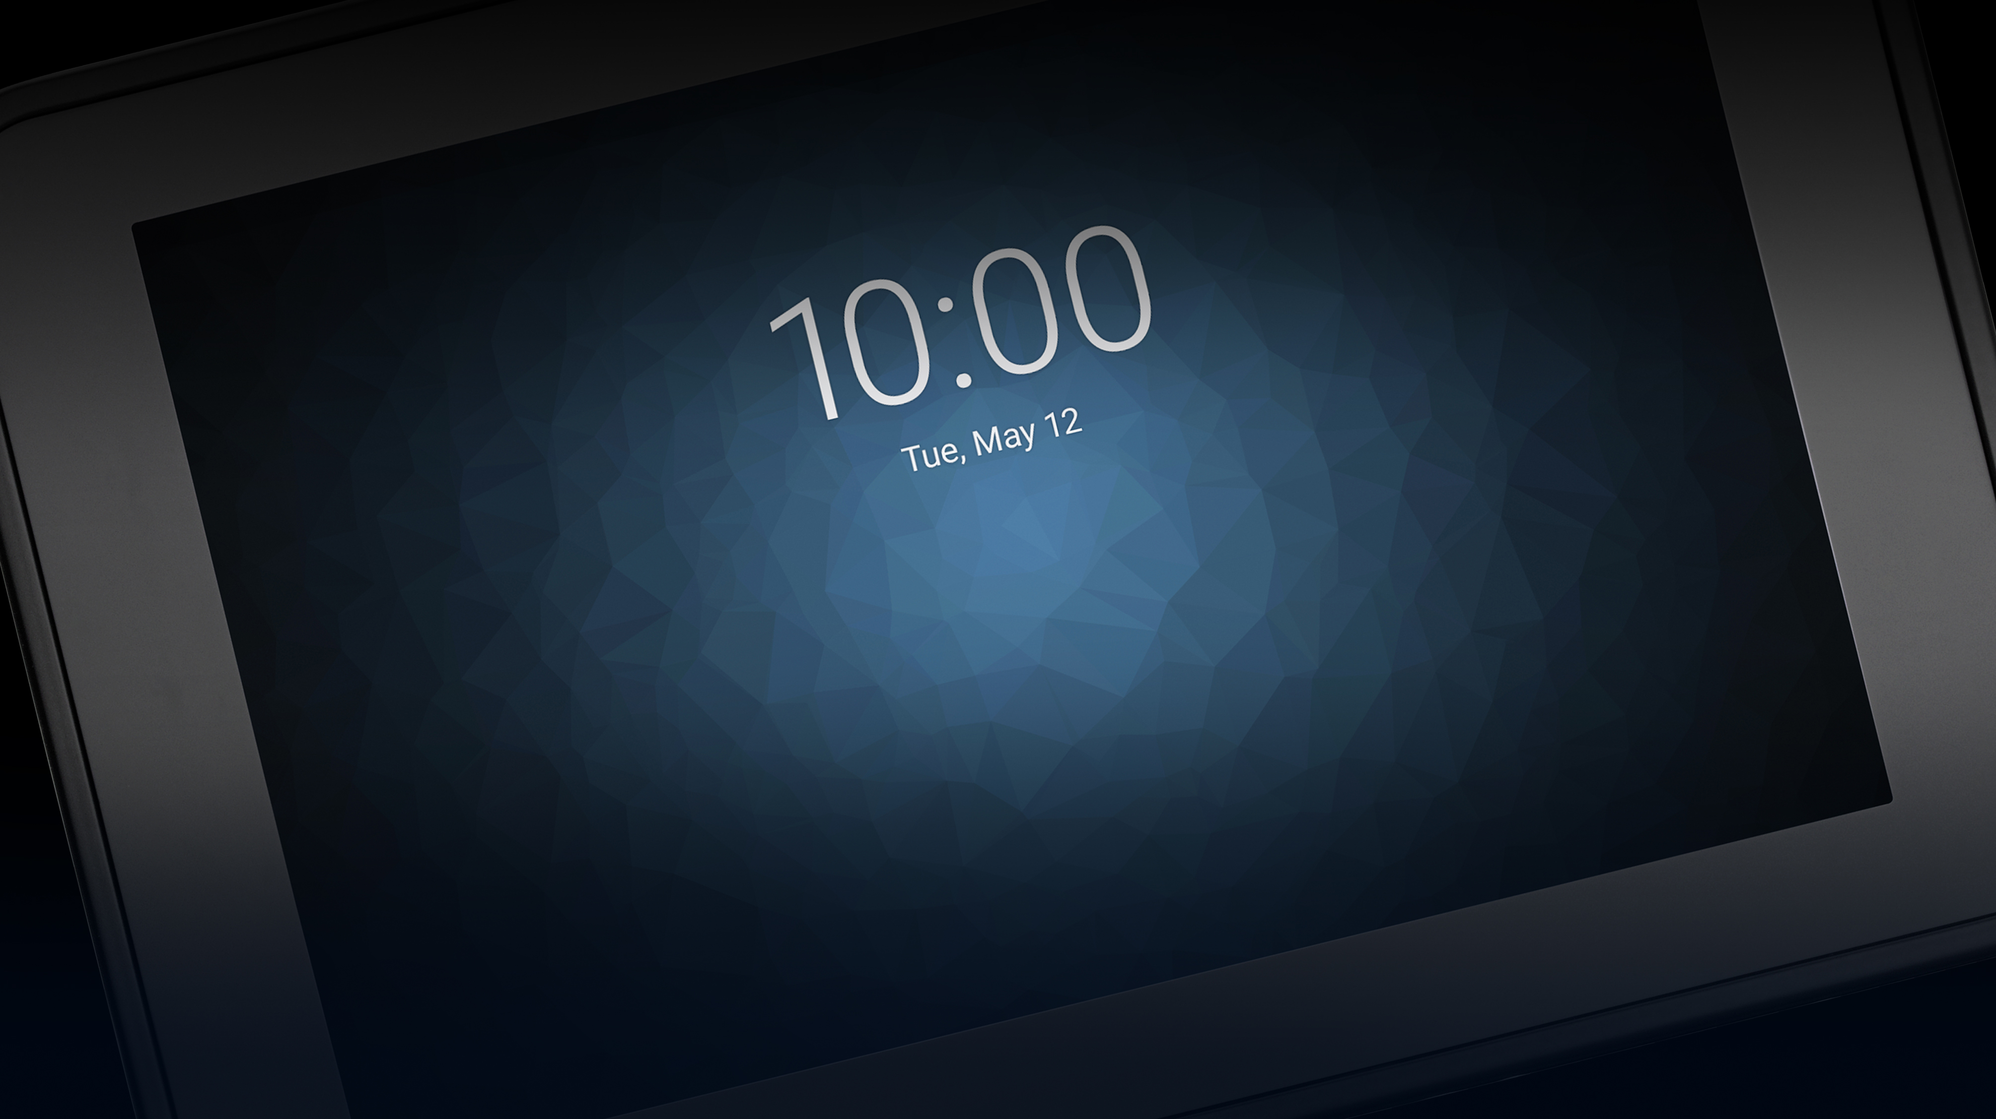
TABLE OF CONTENTS
Customer Engagement Questions: Android and Windows Models Slides 3 - 5
Upgrade Opportunities: Android and Windows Models Slides 6 - 11
Individual Competitive Fight Sheets: Android 8 in. Competitors Slides 12 - 17
Individual Competitive Fight Sheets: Android 10 in. Competitors Slides 18 - 23
ANDROID
COMPETITION
Competitive Feature-to-Feature Comparison Charts: Android 8 in. Competitors Slides 24 - 35
Competitive Feature-to-Feature Comparison Charts: Android 10 in. Competitors Slides 36 - 48
Individual Competitive Fight Sheets: Windows 8 in. Competitors Slides 49 -53
Individual Competitive Fight Sheets: Windows 10 in. Competitors Slides 54 - 59
WINDOWS
COMPETITION
Competitive Feature-to-Feature Comparison Charts: Windows 8 in. Competitors Slides 60 - 69
Competitive Feature-to-Feature Comparison Charts: Windows 10 in. Competitors Slides 70 - 80
Sales Tools: Android and Windows Slides 81 - 83
2

Slide 3
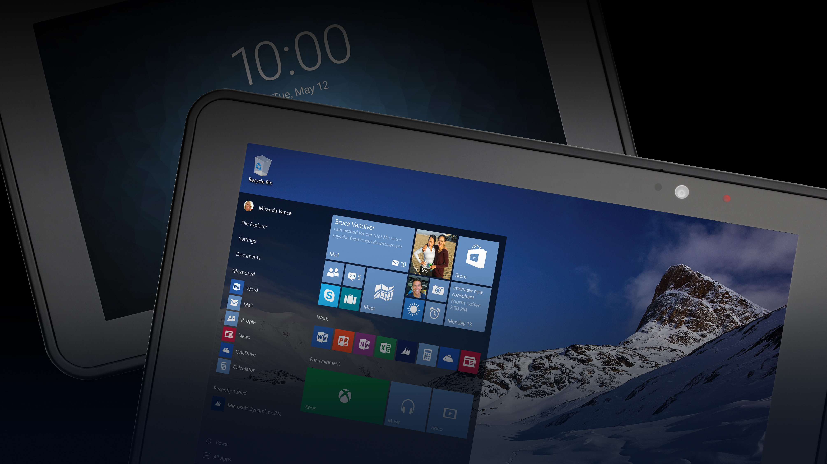
Customer Engagement Questions:
Android and Windows Models
3

Slide 4
Customer Engagement Questions: 1 of 2
Could your workers and managers benefit from the rich data that can be shown on the larger display of a tablet?
Have you considered consumer tablets, and if so, are you concerned about…
Product lifecycle?
Durability of the device?
How IT will manage the devices?
Will the tablets be used in scan-intensive applications? What types of barcodes do workers need to scan?
Do you need an enterprise-class scanning solution capable of first-time, every time capture of barcodes, even dirty and damaged ones?
Is battery life a factor? Would you like a user-replaceable or hot-swappable battery?
Would your organization benefit from 24x7 device utilization and power availability?
4

Slide 5
Customer Engagement Questions: 2 of 2
Are you migrating or considering migrating to Android, but are concerned about security, manageability and OS lifecycle?
Do workers experience WiFi “dead spots” in your facility – places where they have trouble connecting to the wireless network? Would you appreciate the latest WiFi advancements for superior WiFi connections?
What are your environmental requirements? Do workers encounter moisture or dust? Is a 5.9 ft./1.8 m drop to concrete specification important to you?
Do you need to use tablets in vehicles, such as forklifts or delivery trucks?
Are you using other Zebra mobile computers? Did you know that the ET51/ET56 shares the same ShareCradle charging system as other Zebra mobile computers?
What type of accessories do you need? Do you need chargers and cradles for desktops or vehicles, or multi-slot chargers and cradles for the backroom? Do you need a wide variety of carrying accessories to maximize comfort for your workers?
What level of post-sales service and support do you expect?
5

Slide 6
Upgrade Opportunities:
Android and Windows Models
6

Slide 7
Upgrade Opportunity: ET51/ET56 vs. ET50/ET55 Android/Windows
The following chart highlights the new features and advancements in the ET51/ET56 Android and Windows models.
Chart Page 1 of 5
Feature | ET51/ET56 | ET50/ET55 | Why it Matters
Size | 8.4 in.: 228 mm W x 150 mm H x 12.7 mm D 10.1 in.: 269 mm W x 181 mm H x 12.7 mm D | 8.3 in.: 228 mm W x 150 mm H x 12.5 mm D 10.1 in.: 269 mm W x 181 mm H x 12.5 mm D | The ET51/ET56 offers essentially the same external dimensions and weight as the ET50/ET55.
Weight | 8.4 in.: 1.12 lbs/514 g (ET51) 8.4 in: 1.15 lbs/527 g (ET56) 10.1 in.: 1.60 lbs/745 g (ET51) | 8.3 in.: 555g 10.1 in.: 750g
Display | 8.4 in. 2560 x 1600; 720 nit 10.1 in. 2560 x 1600; 540 nit Multi-touch Passive stylus support | 8.3 in.: 1920 x 1200; 440 nit 10.1 in.: 1920 x 1200; 350 nit Multi-touch Pen support | The display is slightly larger, offers a higher resolution and is brighter for better viewing characteristics for indoor and outdoor use. Note that the ET51/ET56 supports a passive stylus; it is not compatible with the ET50/ET55’s active stylus.
Memory | Android: 4GB RAM/32GB Flash Windows: 4GB RAM/64GB Flash | Android: 2GB RAM/32GB Flash Windows: 4GB RAM/64GB Flash | The ET51/ET56 offers more standard memory for better application performance. Additional memory configurations will be considered after initial releases / CPR.
Expandable Memory | MicroSDXC up to 200 GB | MicroSDXC up to 2TB | The ET51/ET56 offers the most expandable memory in its class.

Slide 8
Upgrade Opportunity: ET51/ET56 vs. ET50/ET55 Android/Windows
The following chart highlights the new features and advancements in the ET51/ET56 Android and Windows models.
Chart Page 2 of 5
Feature | ET51/ET56 | ET50/ET55 | Why it Matters
Operating System | Android 8.01 Oreo + support for P, Q and R Windows 10 IoT Enterprise | Android 6.0 Marshmallow Windows IoT Enterprise (originally Windows 8.1) | Android: Advantages of Android 8.1 Oreo vs. Android 6.0 Marshmallow include: Multi-window split-screen support allows workers to see two apps at once Movable Picture-in-Picture support allows technicians to finish watching video to assist in completing a repair while answering a text message OS optimizations for faster application performance Direct communication with other WiFi devices without an access point to improve wireless performance Better battery life by monitoring and reducing apps running in the background Instant access to notifications Windows: Advantages of Windows 10 IoT Enterprise include: Limited forced OS updates 10 years of support for each update Purpose built for non-PC devices Contains only the essential Windows components to reduce the footprint on the tablet — without reducing functionality

Slide 9
Upgrade Opportunity: ET51/ET56 vs. ET50/ET55 Android/Windows
The following chart highlights the new features and advancements in the ET51/ET56 Android and Windows models.
Chart Page 3 of 5
Feature | ET51/ET56 | ET50/ET55 | Why it Matters
Processor | Android: Qualcomm SD660/SDM660 octa-core 2.2 GHz Windows: Intel Atom E3940 quad-core 2MB cache 1.6 GHz (up to 1.8Ghz TFM) | Android: Intel quad-core 1.33 GHz Windows: Intel Atom Z3795 quad-core 2MB cache, 1.59 GHz (up to 2.39 GHz TFM) | Android: The latest processor provides a substantial increase in processing power, delivering superior performance on all voice and data applications. Windows: More memory channels and support for faster memory delivers 99% increase in memory bandwidth.* Delivers improved performance: more processing power, increased power efficiency, improved performance for graphics and media processing (ideal for media-rich applications) and virtual elimination of latency in applications (1 microsecond). * Source: http://www.cpu-world.com/Compare/31/Intel_Atom_ Z3795_vs_Intel_Atom_x5_E3940.html
Battery | Main internal battery (replaceable on site): Android 8.4 in.: 6440 mAh / 3.8V / 24.4 Wh; Li-Polymer 10.1 in.: 9660 mAh / 3.85V / 37.1 Wh; Li-Polymer Windows 8.4 in.: 3300 mAh / 7.6V / 25.1 Wh; Li-Polymer 10.1 in.: 4950 mAh / 7.7V / 38.1 Wh; Li-Polymer Optional hot-swappable PowerPack battery Additional 3400 mAh / 7.2V / 24.5 Wh User-removable/replaceable for perpetual power | Main internal battery: 8.3 in.: 5,900 mAh 10.1 in.: 8,700 mAh Replaceable on site Optional hot-swappable PowerPack battery Additional 3400 mAh / 7.2V / 24.5 Wh User-removable/replaceable for perpetual power | While the battery in the ET50/55 has a higher mAh rating, the ET51/ET56 uses power more efficiently. For example, while the display is brighter for easier viewing in the ET51/ET56, the power consumption is nearly the same as the display in the ET50/ET55 — even though the screen is about 55% brighter.

Slide 10
Upgrade Opportunity: ET51/ET56 vs. ET50/ET55 Android/Windows
The following chart highlights the new features and advancements in the ET51/ET56 Android and Windows models.
Chart Page 4 of 5
Feature | ET51/ET56 | ET50/ET55 | Why it Matters
WLAN (WiFi) | Android: 802.11 a/b/g/n/ac/d/h/i/k/r 2x2 MU-MIMO Windows: 802.11 a/b/g/n/ac/r/k/v 2x2 MIMO | Android: 802.11a/b/g/n/ac/d/h/I 2x2 MIMO Windows: 802.11 a/b/g/n/k/r 2x2 MIMO | Android: Support for the latest WiFi technology for faster and more dependable WiFi connections throughout your customer’s facility. 802.11ac provides the fastest available WiFi speeds. 2x2 MU-MIMO allows access points to simultaneously accommodate requests for service from multiple devices and shifts processing from mobile devices to access points, improving battery cycle times. And WorryFree WiFi (A Mobility DNA solution) delivers near instant application response times, unmatched roaming performance, exceptional voice quality and superior network diagnostics. Windows: Support for the latest WiFi technology for faster and more dependable WiFi connections throughout your customer’s facility. 802.11ac and 2x2 MIMO increase WiFi range and performance. And support for 802.11v (along with 802.11r and k) improves the roaming experience.
Bluetooth | Android: V5.0; 2.1+EDR Class 2: 10 meters, 33 feet Windows: V4.2 Class 1: 100 meters, 328 feet | Android: V4.1 Class 2: 10 meters, 33 feet Windows: V4.0 Class 2: 10 meters, 33 feet | Android: Bluetooth 5.0 delivers twice the speed and four times the power of Bluetooth 4.x, greatly improving performance and reliability for peripherals, such as headset, scanners and printers. Windows: Bluetooth 4.2 improves speed and privacy. Compared to previous versions, BLE 4.2 enables 250% faster and more reliable over-the-air data transmission and 10x more packet capacity. And Class 1 Bluetooth delivers a 10x increase in range — from 10 meters to 100 meters.

Slide 11
Upgrade Opportunity: ET51/ET56 vs. ET50/ET55 Android/Windows
The following chart highlights the new features and advancements in the ET51/ET56 Android and Windows models.
Chart Page 5 of 5
Feature | ET51/ET56 | ET50/ET55 | Why it Matters
Operating temp. range | -4° to 122° F (-20° to 50° C) | 32° to 122° F (0° to 50° C) | The ET51/ET56 has a wider operating temperature range, and is able to reliably operate in sub-freezing temperatures ─ increasing durability and enabling the ET51/ET56 to operate in more environments and applications.
Accessories | Compatibility with most of the ET50/55 accessories | Full dock, single and multiple-slot battery and device ShareCradles; expansion backs with options for integrated scanners, PowerPack Battery Extender (3400 mAh), rotating handstrap, carrying options, rugged frame | The ET51/ET56 is compatible with many ET50/ET55 accessories, preserving your customer’s existing accessory investment for a cost-effective upgrade. (Note: ET50/ET55 internal batteries, screen protectors, and active styli cannot be used with the ET51/ET56.).
Mobility DNA (ANDROID MODELS ONLY) | While the ET50/55 and ET51/56 Android models support the same set of Mobility DNA applications, there are many new Mobility DNA applications that have been developed and launched since the launch of the ET50/55. Today, there are 15 Mobility DNA applications for the ET5X tablets and counting – Zebra is always developing new Mobility DNA tools. Of these tools, 6 are pre-loaded and provided at no cost, 6 are also no-cost but must be downloaded by the customer and 3 are fee-based and downloadable. |  | If you have ET50/55 customers that are upgrade prospects, chances are they may not be aware of all the new high-value Mobility DNA applications that have become available since they purchased their ET50/55s.

Slide 12
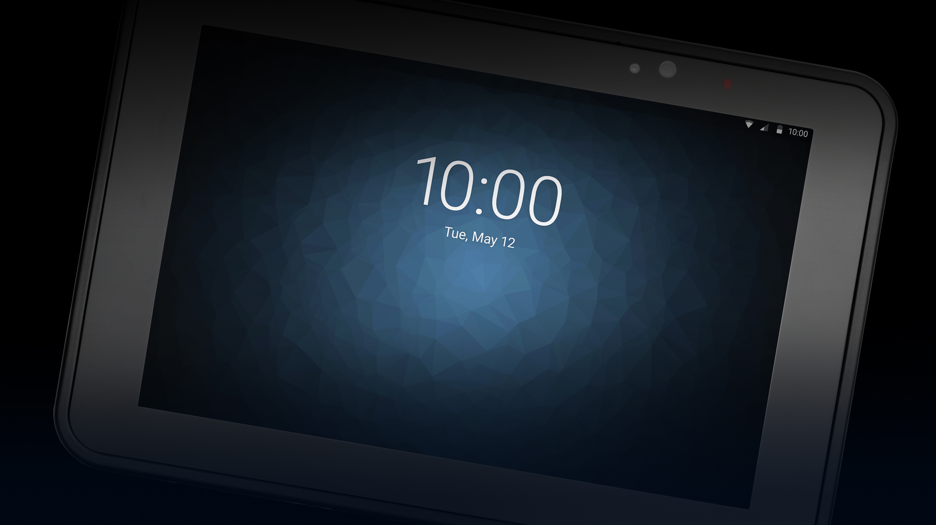
Individual Fight Sheets: 8-inch Android Competitors
12

Slide 13
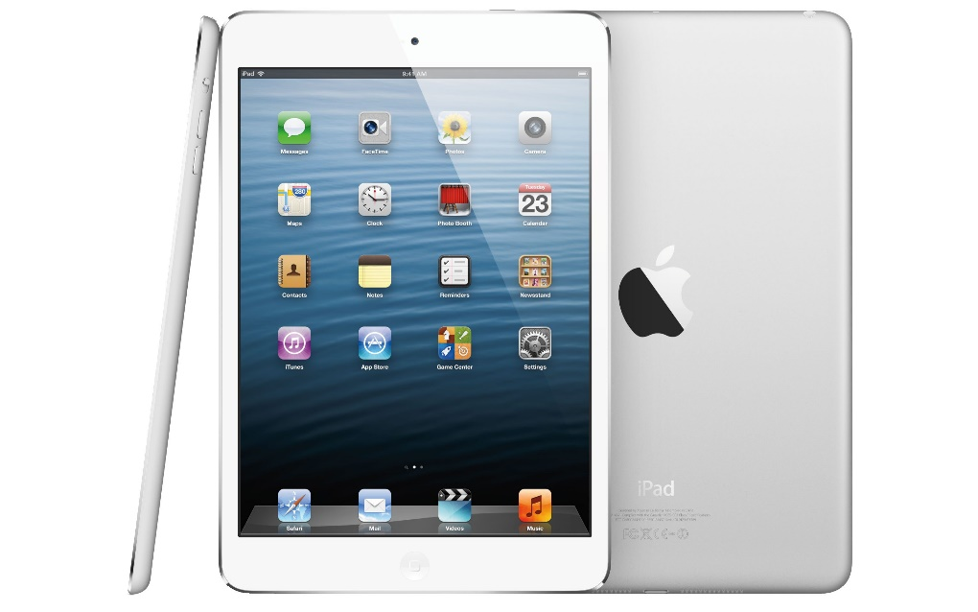
Android Fight Sheet
Apple iPad Mini
KEY weaknesses
No connectors. The ET51/56 offers standard docking connector, rugged docking connector for use with rugged dock (for forklifts and other vehicles); USB-C for data
No equivalent to Expansion Back to add new feature, for example, a second battery; enterprise-class scanner, rotating handstrap and more
Inferior WiFi — no 801.22ac, 2x2 MU-MIMO or WorryFree WiFi
No perpetual power – no hot-swappable user-removable/replaceable second auxiliary battery; no on-site replaceable main internal battery
No enterprise-class barcode scanning
Lower resolution rear camera: 8 MP vs. 13 MP
Lower resolution front camera
Not rugged — no drop test, no sealing, no subzero use, no Corning® Gorilla® Glass display
No freezer or subzero use: 32° F/ 0° C vs. -4° F/ -20° C
Display: smaller (7.9 in. vs 8.4 in), less bright display (500 vs. 720 nit)
No USB-C port for extended data storage (ET5x is up to 256MB); no user accessible 2 TB Micro SDXC card
No Mobility DNA equivalent
Accessories: no enterprise-class accessories, from docks to chargers to wearing options and backroom charging infrastructure
KEY strengths
Smaller and lighter — nearly half the thickness and half the weight
Offers more storage (8x the ET51/56)
Front camera is higher resolution: 7 MP vs 5 MP
13

Slide 14
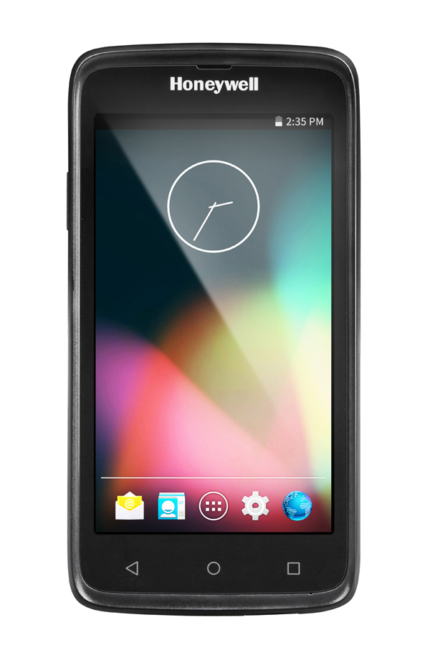
Android Fight Sheet
Honeywell EDA70
KEY weaknesses
About 65% thicker and slightly heavier
Fewer connectors — no standard or rugged docking connectors, no USB-C port for extra data storage
Older OS and no future OS support — Android 7.1 vs. Android 8.1 with support for P, Q and R
Slower processor — 1.2 GHz quad-core vs. 2.2 GHz octo-core
50% less memory: 2GB/16GB vs 4GB/32GB
No equivalent to Expansion Back to add new features, such as a second battery
No USB-C port for less external data storage — 32GB vs. 256GB; no user accessible 2 TB Micro SDXC card
Inferior WiFi — no ‘ac’, no WorryFree WiFi, no 2x2 MU-MIMO
No cellular option
Inferior Bluetooth — V4.0 vs. V5.0 + 2.1+EDR
No perpetual power – no hot-swappable user-removable/replaceable second auxiliary battery; no on-site replaceable main internal battery
Inferior maximum drop spec — no optional rugged frame to provide 5.9 ft./1.8 m drop spec
Inferior cameras: Front – 5MP vs 13 MP; Rear – no camera vs 5 MP
Inferior maximum drop spec — no optional rugged frame to provide 5.9 ft./1.8 m drop spec
Inferior sealing: IP64 vs. IP65
No subzero use: lowest operating temperature is 14° F/ -10° C vs. -4° F/ -20° C
Display weaknesses: smaller (7 in. vs 8.4 in.); lower resolution (1280x720 vs 2560x1600), no nit rating or Corning Gorilla Glass, no support for glove or when wet
No Mobility DNA equivalent
KEY STRENGTHS
Higher standard drop specification: 4 ft./1.2 m vs. 3.3 ft./1 m
Tumble tested
14

Slide 15
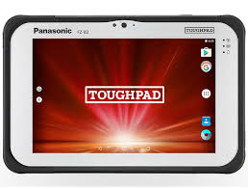
Android Fight Sheet
Panasonic FZ-B2
KEY Weaknesses
About 40% thicker and a little heavier
Fewer connectors: no rugged connectors for vehicle mount, i.e. forklifts
Older OS with no future support: Android 6.0.1 Marshmallow vs. Android 8.1 Oreo with support for P, Q and R
Slower processor: 1.92 GHz quad-core vs. 2.2 GHz octo-core
Half the RAM: 2GB vs 4 GB
No equivalent to Expansion Back to add new features, such as a second battery
No USB-C port for limited extended data storage: 32GB vs 256GB; no user accessible 2 TB Micro SDXC card
Inferior WiFi — no WorryFree WiFi or 2x2 MU-MIMO
Inferior Bluetooth — V4.2 with EDR vs. V5.0 + 2.1+EDR
No perpetual power – no hot-swappable user-removable/replaceable second auxiliary battery; no on-site replaceable main internal battery
Lower capacity standard battery: 3220 mAh vs. 6440 mAh
Inferior cameras: Rear — 8 MP vs. 13 MP; Front — 720p webcam vs. 5 MP
Inferior maximum drop spec — no optional rugged frame to provide 5.9 ft./1.8 m drop spec
Display weaknesses: Smaller (7 in. vs 8.4 in.); lower resolution (1280x800 vs 2560x1600); 500 vs 720 nit; no Corning Gorilla Glass
No Mobility DNA equivalent
KEY strengths
Battery: optional extended 7100 mAh battery; bridge battery for battery swaps
More rugged: Higher standard drop spec (5 ft./1.5m vs 3.3 ft./1m); has tumble spec; higher IP67 sealing
15

Slide 16
Android Fight Sheet
Panasonic FZ-L1
KEY weaknesses
Fewer connectors: no rugged connectors for vehicle mount, i.e. forklifts
No USB-C port for less external data storage; no user accessible 2 TB Micro SDXC card
No future OS support, unlike the ET51/ET56, which supports P, Q and R
Slower processor: 1.1 GHz quad-core vs. 2.2 GHz octo-core
Half the memory: 2GB/16GB vs 4GB/32GB
No equivalent to Expansion Back to add new features, such as a second battery
Inferior WiFi — no ‘ac’, no WorryFree WiFi, no 2x2 MU-MIMO
Inferior Bluetooth — V4.2 vs. V5.0 + 2.1+EDR
50% lower capacity battery — 3200 mAh vs 6440 mAh
No perpetual power – no hot-swappable user-removable/replaceable second auxiliary battery; no on-site replaceable main internal battery
Inferior barcode scanning: SE4710 vs. SE4750
Inferior cameras: Rear — 13 MP vs 8 MP; Front — no front camera vs. 5 MP
Inferior maximum drop spec — no optional rugged frame to provide 5.9 ft./1.8 m drop spec
Display weaknesses: Smaller (7 in. vs 8.4 in.); lower resolution (1280x800 vs 2560x1600), no nit rating for outdoor readability; no Corning Gorilla Glass
No Mobility DNA equivalent
KEY STRENGTHS
Lighter
More rugged: higher standard drop spec (5 ft./1.5m vs 3.3 ft./1m); has tumble spec; higher IP67 sealing
Warm swap main battery
16

Slide 17
Android Fight Sheet
Samsung Galaxy Tab Active2
KEY Weaknesses
No USB-C port for less external data storage; no user accessible 2 TB Micro SDXC card
No equivalent to Expansion Back to add new features, such as a second battery
Older OS with no future support: Android 7.0.1 Nougat vs. Android 8.1 Oreo with support for P, Q and R
Slower processor: 1.6 GHz octo-core vs. 2.2 GHz octo-core
Less memory: 3GB/16GB vs. 4GB/32GB
Inferior WiFi — no WorryFree WiFi, no 2x2 MU-MIMO
Lower capacity battery — 4450 mAh vs 6440 mAh
No perpetual power – no hot-swappable user-removable/replaceable second auxiliary battery; no on-site replaceable main internal battery
No enterprise-class scanning option
Lower resolution rear camera: 8 MP vs 13 MP
Inferior maximum drop spec — no optional rugged frame to provide 5.9 ft./1.8 m drop spec
Display weaknesses: Smaller (8 in. vs 8.4 in.); lower resolution (1280x800 vs 2560x1600), no nit rating for outdoor readability
Accessories: third party only, fewer available accessories
No Mobility DNA equivalent
KEY strengths
Slightly thinner and lighter
Higher IP68 sealing
17

Slide 18
Individual Fight Sheets: 10-inch Android Competitors
18

Slide 19
Android Fight Sheet
Apple iPad
KEY Weaknesses
No connectors rugged docking connector for use with rugged dock (for forklifts and other vehicles)
No equivalent to Expansion Back to add new features, such as a second battery
Inferior WiFi — no 2x2 MU-MIMO or WorryFree WiFi
No perpetual power – no hot-swappable user-removable/replaceable second auxiliary battery; no on-site replaceable main internal battery
No enterprise-class barcode scanning
Not rugged — no drop test, no sealing, no subzero use, no Corning Gorilla Glass display
Display — smaller: 9.7 in. vs 10.1 in.; lower resolution (2388x1668 vs. 2650x1600), no Corning Gorilla Glass; no support for glove or when wet
No USB-C port for limited extended data storage (ET5X offers up to 256GB); no user accessible 2 TB Micro SDXC card
No Mobility DNA equivalent
Accessories: no enterprise-class accessories, from docks to chargers to wearing options and backroom charging infrastructure
KEY strengths
Smaller and lighter — nearly half the thickness and about 35% lighter
Offers more storage (4x the ET51/56)
Slightly brighter display for outdoor readability: 600 vs 540 nit
19

Slide 20
Android Fight Sheet
Bluebird Pidion RT100
KEY weaknesses
Slightly thicker and slightly heavier
Fewer connectors: no rugged connectors for vehicle mount, i.e. forklifts
No equivalent to Expansion Back to add new features, such as a second battery
Much older OS with no future support: Android 4.4 KitKat vs. Android 8.1 Oreo with support for P, Q and R
Slower processor: 1.83 GHz quad-core vs. 2.2 GHz octo-core
Less memory: 2GB/16GB or 32GB vs. 4GB/32GB
No USB-C port for limited extended data storage: 64GB vs 256GB; no user accessible 2 TB Micro SDXC card
Inferior WiFi — no ‘ac’, no WorryFree WiFi, no 2x2 MU-MIMO
Inferior Bluetooth — V4.0 vs. V5.0
Lower capacity battery — 6000 mAh vs 9660 mAh
No perpetual power – no hot-swappable user-removable/replaceable second auxiliary battery; no on-site replaceable main internal battery
Inferior maximum drop spec — no optional rugged frame to provide 5.9 ft./1.8 m drop spec
No enterprise-class scanning option
Inferior cameras: Rear– 5MP vs 13 MP; Front– 2 MP vs 5 MP
No subzero use: lowest operating temperature is 14° F/ -10° C vs. -4° F/ -20° C
Display weaknesses: lower resolution (1280x800 vs 2560x1600), no nit rating for outdoor readability, no support for glove or when wet
No Mobility DNA equivalent
KEY STRENGTHS
Higher standard drop specification: 4 ft./1.2 m vs. 3.3 ft./1 m
20

Slide 21
Android Fight Sheet
Data Limited DLI10
KEY weaknesses
Over 50% thicker and over 80% heavier
Fewer connectors — no standard or rugged docking connectors, no USB-C port for extra data storage
Older OS with no future support: Android 6.0.1 Marshmallow vs. Android 8.1 Oreo with support for P, Q and R
No USB-C port for limited extended data storage (ET5X offers up to 256GB); no user accessible 2 TB Micro SDXC card
Slower processor — 1.8 GHz quad-core vs. 2.2 GHz octo-core
Inferior WiFi — no WorryFree WiFi or 2x2 MU-MIMO
No equivalent to Expansion Back to add new features, such as a second battery
Inferior Bluetooth — V4.0 vs. V5.0
No perpetual power – no hot-swappable user-removable/replaceable second auxiliary battery; no on-site replaceable main internal battery
50%+ lower capacity battery — 3950 mAh vs 9660 mAh
Inferior cameras: Rear – 5MP vs 13 MP; Front – 2 MP vs 5 MP
Inferior maximum drop spec — no optional rugged frame to provide 5.9 ft./1.8 m drop spec
Lower sealing: IP54 vs. IP65
No subzero use: lowest operating temperature is 14° F/ -10° C vs. -4° F/ -20° C
Display weaknesses: smaller (9.7 in. vs 10.1 in) lower resolution (1024x768 vs 2560x1600), lower nit rating (350 vs 540), doesn’t work with gloves or when wet, no Corning Gorilla Glass
No Mobility DNA equivalent
Fewer enterprise class accessories
KEY strengths
Higher standard drop specification: 4 ft./1.2 m vs. 3.3 ft./1 m
Twice the standard Flash (64GB vs. 32GB); higher memory option (256GB)
Has bridge battery
More enterprise class scanning options: 1D laser and 1D long range laser
21

Slide 22
Android Fight Sheet
Lenovo Tab 4 10 Business
KEY Weaknesses
Fewer connectors — no standard or rugged docking connectors,
No USB-C port for limited extended data storage (ET5X offers up to 256GB); no user accessible 2 TB Micro SDXC card
No equivalent to Expansion Back to add new features, such as a second battery
Older OS with no future support: Android 7.1 Nougat vs. Android 8.1 Oreo with support for P, Q and R
Slower processor — 1.4 GHz quad-core vs. 2.2 GHz octo-core
Half the memory: 2GB/16GB vs 4GB/32GB
Inferior WiFi — no ‘ac’, no WorryFree WiFi or 2x2 MU-MIMO
Inferior Bluetooth — V4.0 vs. V5.0
Lower capacity battery — 7000 mAh vs 9660 mAh
No perpetual power – no hot-swappable user-removable/replaceable second auxiliary battery; no on-site replaceable main internal battery
No enterprise-class scanning option
Inferior cameras: Rear – 5MP vs 13 MP; Front – 2 MP vs 5 MP
Not rugged: no drop specification or sealing
Display weaknesses: lower resolution (1280x800 vs 2560x1600), lower nit rating (350 vs 540), doesn’t work with gloves or when wet, no Corning Gorilla Glass
No Mobility DNA equivalent
Fewer enterprise-class accessories
KEY strengths
Thinner and lighter
22

Slide 23
Android Fight Sheet
Panasonic FZ-A2
KEY weaknesses
Thicker and heavier
No rugged docking connectors
Older OS with no future support: Android 6.0.1 Marshmallow vs. Android 8.1 Oreo with support for P, Q and R
Slower processor — 1.44 GHz quad-core vs. 2.2 GHz octo-core
No USB-C port for limited extended data storage: 64GB vs 256GB; no user accessible 2 TB Micro SDXC card
No equivalent to Expansion Back to add new features, such as a second battery
Inferior WiFi — no WorryFree WiFi or 2x2 MU-MIMO
Inferior Bluetooth — V4.2 vs. V5.0
Lower capacity battery — 2720 mAh vs 9660 mAh
No perpetual power – no hot-swappable user-removable/replaceable second auxiliary battery; no on-site replaceable main internal battery
No enterprise-class scanning option
Inferior cameras: Rear – 8MP vs 13 MP; Front – 2 MP vs 5 MP
Inferior maximum drop spec — no optional rugged frame to provide 5.9 ft./1.8 m drop spec
Display: lower resolution (1920x1200 vs 2560x1600)
No Mobility DNA equivalent
Fewer enterprise-class accessories
KEY strengths
Has bridge battery
Higher standard drop specification: 5 ft./1.5 m vs. 3.3 ft./1 m
Higher nit rating for outdoor readability: 800 vs 540
23

Slide 24
Competitive Feature-to-Feature Comparison Charts: 8-inch Android
24

Slide 25
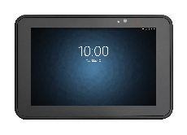
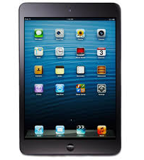
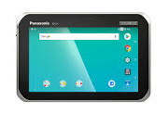
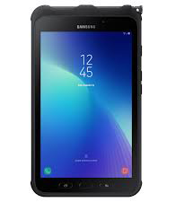
Android Competitive Comparison: 8-inch tablets
In the following chart, where appropriate, yellow shading indicates the best specification available for a feature. Competitive information is based on publicly available information.
Feature | Zebra ET51/ET56 | Apple iPad Mini 7.9 in. | Honeywell EDA70 | Panasonic FZ-B2 | Panasonic FZ-L1 | Samsung Galaxy Tab Active2 | Why it matters
Physical
Thickness | 0.5 in./12.7 mm | 0.24 in./6.1 mm | 0.83 in./21 mm | 0.71 in./18 mm | 0.5 in/12.7 mm | 0.4 in/10 mm | While consumer devices like the iPad Mini are much lighter and slimmer, these devices do not offer the same level of ruggedness as the ET51/ET56 and will require accessories to increase durability (and the rugged accessories add weight and thickness). The ET51/ET56 is one of the thinner and lighter enterprise-class and rugged tablets in its class.
Weight | WiFi only: ET51: 1.12 lbs/514 g WiFi/cellular: ET56: 1.15 lbs/527 g | WiFi only: 0.66 lbs/300.5 g WiFi/cellular: 0.68 lbs/308.2 g | 1.21 lbs/550 g with battery pack | 1.2 lbs/554 g | 0.93 lbs./422 g | 0.92 lbs/417 g
Physical connectors | Docking connector (charge and data) Rugged connector for use with rugged dock (charge and data) USB-C side port (data only) | Lightning connector | Custom I/O connector | Docking connector; USB 3.0; USB Type-C | Docking connector; Micro USB (host or client) | Docking connector USB 2.0 Type-C | The ET51/ET56 offers the most versatility and flexibility through its connectors. For example, the docking station connector allows the ET51/ET56 tablets to double as desktop solutions. A single docking station supports the ET51 and the ET56, with or without the rugged frame. And the rugged connector connects to rugged mounting cradles to enable use in forklifts and other vehicles.

Slide 26
Android Competitive Comparison: 8-inch tablets
In the following chart, where appropriate, yellow shading indicates the best specification available for a feature. Competitive information is based on publicly available information.
Feature | Zebra ET51/ET56 | Apple iPad Mini 7.9 in. | Honeywell EDA70 | Panasonic FZ-B2 | Panasonic FZ-L1 | Samsung Galaxy Tab Active2 | Why it matters
Performance Characteristics
Operating System | Android 8.1 Oreo, upgradeable through Android R | iOS12 | Android 7.1 Nougat | Android 6.0.1 Marshmallow | Android 8.1 Oreo | Android 7.1 Nougat | The ET51/ET56 offers the most advanced Android operating system, and is the only device in its category to offer support for the next three releases, P, Q and R.
Processor | Qualcomm SnapdragonTM 660 octa-core 2.2 GHz | A12 Bionic | 1.2 GHz Qualcomm MSM8916 quad-core | Intel® AtomTM x5-Z8550 quad-core; 1.92 GHz | Qualcomm® MSM8909 1.1GHz quad-core | 1.6 GHz, octa-core | The ET51/ET56 offers the fastest processor in its class, providing the fastest and most robust application performance.
Memory (RAM/ Flash) | 4GB RAM/ 32GB eMMC Flash | Up to 256GB storage | 2GB RAM; 16GB Flash | 2GB SDRAM 32GB eMMC5 | 2 GB RAM; 16GB | 3 GB RAM; 16GB | With the most memory in this class, the ET51/ET56 can run multiple simultaneous programs without eroding performance.
Expansion | Expansion Back; Micro SDXC slot (supports up to 200 GB); USB-C port (data only) | None | User-accessible Micro SD card up to 32GB (SDHC/SDIO-compliant) | Micro SDHC: up to 32GB | Micro SD: up to 2GB Micro SDHC: up to 32GB Micro SDXC: Up to 64GB | Micro SD up to 256GB | Integrated connector to easily add accessories; only tablet in this class to support Micro SDXC with 200 GB capacity; the USB-C port delivers maximum data transfer speeds and maximum external drive capacity — up to 256GB.

Slide 27
Android Competitive Comparison: 8-inch tablets
In the following chart, where appropriate, yellow shading indicates the best specification available for a feature. Competitive information is based on publicly available information.
Feature | Zebra ET51/ET56 | Apple iPad Mini 7.9 in. | Honeywell EDA70 | Panasonic FZ-B2 | Panasonic FZ-L1 | Samsung Galaxy Tab Active2 | Why it matters
Wireless Communications
WiFi | 802.11 a/b/g/n/d/h/i/k/r/ac; IPv4; IPv6; dual band 2x2 MU-MIMO for transmit and receive | 802.11a/b/g/n | 802.11 a/b/g/n; Wi-Fi certified | 802.11a/b/g/n/ac | 802.11a/b/g/n/d/h/i/r | 802.11a/b/g/n/ac | The ET51/ET56 offers maximum WiFi performance, period. The ET51/ET56 are the only tablets in this class to support 802.11ac for the fastest WiFi speeds, 802.11r for the fastest roaming, and 2x2 MU-MIMO for increased WiFi range and performance.
Cellular | ET56 only: Global LTE (data only); North America LTE (data only): AT&T and Verizon | Model A1454: GSM/EDGE (850, 900,1800, 1900 MHz) UMTS/HSPA+/DC-HSDPA (850, 900, 1900, 2100 MHz) LTE (Bands 4 and 17) | None | Optional 4G LTE mobile broadband with satellite GPS9 | 4G LTE, HSPA+, UMTS, EDGE, GPRS, GSM | LTE Cat 6 (300 Mbps), AT&T and Verizon | The ET56 offers global coverage for cellular networks.

Slide 28
Android Competitive Comparison: 8-inch tablets
In the following chart, where appropriate, yellow shading indicates the best specification available for a feature. Competitive information is based on publicly available information.
Feature | Zebra ET51/ET56 | Apple iPad Mini 7.9 in. | Honeywell EDA70 | Panasonic FZ-B2 | Panasonic FZ-L1 | Samsung Galaxy Tab Active2 | Why it matters
Wireless Communications - continued
Bluetooth | Bluetooth v5.0 / 2.1+EDR Class 2 (Bluetooth LE) | Bluetooth 5.0 | Bluetooth Class 2 v4.0 | Bluetooth Class 1, v4.2 with EDR | Bluetooth Class 1, v4.2 Classic Mode LE | Bluetooth v.4.2 | Offers the most advanced release of Bluetooth, delivering twice the speed and four times the range with less power, compared to the prior generation of Bluetooth (v4.x). The result is better Bluetooth peripheral performance, from scanners and headsets to printers.
GPS | ET56 only: GNSS supports GPS, Galileo and GLONASS with LTO technology for Assisted-GPS without sacrificing autonomous operation | A-GPS, GLONASS, Galileo and QZSS | GNSS receiver for Beidou, GPS, and GLONASS | Optional | GPS GLONASS CEP50 | GLONASS | The ET51/ET56 supports the most options for autonomous and assisted GPS, providing connectivity in more locations and challenging areas, improving locationing accuracy and application performance.

Slide 29
Android Competitive Comparison: 8-inch tablets
In the following chart, where appropriate, yellow shading indicates the best specification available for a feature. Competitive information is based on publicly available information.
Feature | Zebra ET51/ET56 | Apple iPad Mini 7.9 in. | Honeywell EDA70 | Panasonic FZ-B2 | Panasonic FZ-L1 | Samsung Galaxy Tab Active2 | Why it matters
Power
Battery | Rechargeable Li-Polymer 6440 mAh, 3.8V, (24.4 Whr) 3400 mAh, 7.2V (24.5 Wh) secondary battery (user replaceable) | 19.1 Whr rechargeable Li-Polymer | Li-Ion, 3.8 V, 4000 mAh with integrated battery diagnostics | Li-Ion battery Standard: 7.2V, typical 3220 mAh, minimum 3050 mAh Long life: 7.2V, typical 7100 mAh, minimum 6800 mAh Optional bridge battery (60 seconds) | Li-ion 3.8V, 3,200 mAh 12 hours | Li-Polymer 4,450 mAh | While the ET51/ET56 offers the 2nd largest capacity battery in this class, it is the only tablet in this class to offer a second hot-swappable user-replaceable second battery for continuous power.
User-replaceable | Yes (optional hot-swappable secondary battery) Internal battery is field replaceable | No | No | No | Yes; warm swap | Yes | With the ET51/ET56 both the optional auxiliary battery and internal battery are replaceable right on site.

Slide 30
Android Competitive Comparison: 8-inch tablets
In the following chart, where appropriate, yellow shading indicates the best specification available for a feature. Competitive information is based on publicly available information.
Feature | Zebra ET51/ET56 | Apple iPad Mini 7.9 in. | Honeywell EDA70 | Panasonic FZ-B2 | Panasonic FZ-L1 | Samsung Galaxy Tab Active2 | Why it matters
Power - continued
Continuous Power | Ample power for a full shift; continuous 24x7 operation is enabled with the secondary optional battery | Up to 10 hours on WiFi Up to 9 hours on cellular data network | 8+ hours | Standard battery: 8 hours Long life battery: 16 hours | 12 hours based on standard enterprise user profile | Up to 11 hours | The ET51/ET56 is one of the few devices in this class to offer an auxiliary user-replaceable battery (via the expansion back) — so the tablet never needs to be taken out of service to charge. This optional auxiliary battery also trickle charges the main battery. When the internal main battery is depleted, it is replaceable right at your customer’s facility, extending tablet lifecycle and reducing ROI.

Slide 31
Android Competitive Comparison: 8-inch tablets
In the following chart, where appropriate, yellow shading indicates the best specification available for a feature. Competitive information is based on publicly available information.
Feature | Zebra ET51/ET56 | Apple iPad Mini 7.9 in. | Honeywell EDA70 | Panasonic FZ-B2 | Panasonic FZ-L1 | Samsung Galaxy Tab Active2 | Why it matters
Data Capture
Barcode Scanning | Moderate to intensive scanning: SE4750 optional advanced imager via the expansion back accessory Occasional scanning: 13 MP high-resolution integrated camera | Via integrated consumer-grade camera | Integrated 1D/2D scanner | Optional: integrated 1D/2D scanner’ | Optional: SE4710 1D/2D barcode reader | Via the integrated 8 MP camera | The ET51/ET56 offers one of Zebra’s industry leading scanning engines via the Expansion Back. The SE4750 delivers Zebra’s exclusive PRZM Intelligent Imaging technology for first-time, every time capture of virtually any 1D/2D barcode in any condition. (For more information on the SE4750 and its scan engine performance, please visit www.zebra.com/se4750)
Rear Camera | 13 MP | 8 MP | 5 MP | 8 MP | 8 MP | 8 MP | The ET51/ET56’s rear camera is best-in-class, providing high resolution images that are ideal for proof of condition and more.
Front Camera | 5 MP | 7 MP | No | 720p webcam | No | 5 MP | The ET51/ET56 offers the highest resolution front camera for video calls that enable on-the-spot help and collaboration.

Slide 32
Android Competitive Comparison: 8-inch tablets
In the following chart, where appropriate, yellow shading indicates the best specification available for a feature. Competitive information is based on publicly available information.
Feature | Zebra ET51/ET56 | Apple iPad Mini 7.9 in. | Honeywell EDA70 | Panasonic FZ-B2 | Panasonic FZ-L1 | Samsung Galaxy Tab Active2 | Why it matters
Environmental
Drop/ Tumble Spec. | 3.3 ft./1 m to concrete per MIL-STD-810G With optional rugged frame: 5.9 ft./1.8 m to concrete per MIL-STD-810G | None | 4 ft./1.2 m to concrete at room temp per MIL-STD 810G 200 tumbles @ 1.64 ft./0.5 m | MIL-STD-810G design 5 ft./1.5 m drop 500 3.3 ft./1m tumbles | MIL-STD-810G design 5 ft./1.5 m drop 500 3.3 ft./1m tumbles | 3.93 ft./1.2 m with cover | The optional rugged frame doubles the ET51/ET56’s concrete drop specification, providing the maximum drop specification in this product class.
Sealing | IP65 | None | IP64 | IP65 and IP67 | IP65 and IP67 | IP68 | The ET51/ET56, like other rugged tablets in this class, offers IP65 sealing to protect against dust, spilled liquids and spraying water.
Operating Temperature | -4° F to 122° F/ -20° C to 50° C | 32° F to 95° F/ 0° C to 35° C | -14 °F to 122 °F/ -25 °C to 50 °C | -14 °F to 122 °F/ -25 °C to 50 °C | -14 °F to 122 °F/ -25 °C to 50 °C | Not published | The ET51/ET56 is built to handle subzero temperatures and extreme heat.

Slide 33
Android Competitive Comparison: 8-inch tablets
In the following chart, where appropriate, yellow shading indicates the best specification available for a feature. Competitive information is based on publicly available information.
Feature | Zebra ET51/ET56 | Apple iPad Mini 7.9 in. | Honeywell EDA70 | Panasonic FZ-B2 | Panasonic FZ-L1 | Samsung Galaxy Tab Active2 | Why it matters
Display
Display Size/ Resolution | 8.4 in./21.3 cm; 2560x1600 720 nit | 7.9 in./20.0 cm, 2048x1536 500 nit | 7 in. 1280x720 | 7 in. WXGA 1280 x 800 500 nit | 7 in. 1280 x 720 | 8.0 in./20.3 cm TFT; 480 nit 1280 x 800 | The ET51/ET56 offers the largest, brightest and highest resolution display in this class.
Touch Screen Mode Options | Capacitive 10 point multi-touch; 4 entry styles: Finger/Thin Glove; Stylus; Glove/Finger; Finger only | Multi-Touch display with IPS technology | Rugged, multi-touch capacitive touch panel | Capacitive 10 point multi-touch; glove and rain mode | Capacitive 10 point multi-touch; glove and rain mode | Capacitive 10 point multi-touch; glove and rain mode | With the advanced touch screen technology in the ET51/ET56, every input mode works, even if the display is wet. And unlike competitive devices that offer a glove and rain mode, preferred entry styles that optimize entry performance are available for all modes of entry.
Durability | Corning Gorilla Glass; daylight viewable | Fingerprint-resistant oleophobic coating | Optically bonded | Display with direct bonding | Display with direct bonding | Corning Gorilla Glass; optically bonded | Corning® Gorilla® Glass protects the most vulnerable aspect of any tablet — the display — with shatter and scratch resistance.
Readability | Daylight viewable | Anti-reflective coating | Daylight viewable | Daylight viewable | Not published | Not published | The ET51/ET56 offers class-best brightness, making it the easiest to read in bright sunlight.

Slide 34
Android Competitive Comparison: 8-inch tablets
In the following chart, where appropriate, yellow shading indicates the best specification available for a feature. Competitive information is based on publicly available information.
Feature | Zebra ET51/ET56 | Apple iPad Mini 7.9 in. | Honeywell EDA70 | Panasonic FZ-B2 | Panasonic FZ-L1 | Samsung Galaxy Tab Active2 | Why it matters
Software
Value-add Software Tools | Mobility DNA: Supported by 33 models and counting Management Tools: Enterprise Home Screen LifeGuard StageNow PowerPrecision Console WorryFree WiFi Device Tracker Enterprise Mobility Management Toolkit Productivity Tools: DataWedge Enterprise Keyboard Device Diagnostics PowerPrecision+ Swipe Assist Development Tools: Mobility Extensions (Mx) EMDK for Android Enterprise Browser | No | Honeywell Mobility Edge^{TM:} Supported by 5 models to date Deployment Tools: EZ-Config (legacy Windows-centric tool) Setup Wizard 4 tools planned for release in 2019* Development Tools: Honeywell SDK (limited functionality) Management Tools: Enterprise Launcher Operational Intelligence* Battery Runtime Maximizer Find my Device* Self Diagnostics Optimize Workflow Tools: Voice Wedge* Scan Wedge Wireless Tether | Not published | Not published | Close alliance with SCANDit (scanning performance software) Knox family of solutions: Security: Knox Platform for Enterprise Deployment: Knox Configure; Knox Mobile Enrollment (automated EMM enrollment) Management: Knox Manage (cloud-based EMM); Knox E-FOTA (OS update over the air) | While some competitive devices have some software offerings, only Zebra has a comprehensive portfolio of tools that provide your customers with value they just can’t get in a competitive device. There are 15 tools and counting for the ET51/ET56 – and new Mobility DNA tools are always in the making. Of the 15 tools available today: 6 are free and pre-loaded, ready to use on the ET56/ET56 6 are free but your customers will need to download the software 3 are fee-based and downloadable

Slide 35
Android Competitive Comparison: 8-inch tablets
In the following chart, where appropriate, yellow shading indicates the best specification available for a feature. Competitive information is based on publicly available information.
Feature | Zebra ET51/ET56 | Apple iPad Mini 7.9 in. | Honeywell EDA70 | Panasonic FZ-B2 | Panasonic FZ-L1 | Samsung Galaxy Tab Active2 | Why it matters
Accessories
Enterprise Accessories | ShareCradles (4-slot); docking stations; vehicle mount cradle (third party); single slot charge cradle; 4-slot optional battery charger; rugged frames; expansion back to easily add accessories (scanner/hand strap and optional battery bay or hand strap); passive stylus; holster; shoulder strap; charging cables and more | No enterprise-class accessories | Four-slot device and battery chargers, vehicle dock, RAM mount, batteries, adapter kits/plugs; cigarette adapter power cable; hand straps; shoulder strap; battery door | Single bay desktop cradle; 4-bay battery chargers; standard and extended batteries; hand straps; rotating hand strap; case; portfolio; holster; kneeboard/legstraps; passive stylus | Single bay desktop cradle; 5-bay device and battery chargers; USB chargers; standard battery; hand straps; rotating hand strap; passive stylus | Third party accessories: Single and 5-slot battery chargers; 2-slot and 4-slot charging cradles; batteries; shopping cart kit; protective case; cigarette adapter; barcode sled; external keyboard, vehicle mounts | The ET51/ET56 tablets offer the most accessories in this class for the most flexibility, with accessories that improve ruggedness, expand use cases (for example, in forklifts or as desktop replacements), increase carrying options, and more. And since the majority of accessories are manufactured by Zebra, your customers get quality they can count on.
`

Slide 36
Competitive Feature-to-Feature Comparison Charts: 10-inch Android
36

Slide 37
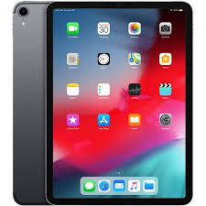
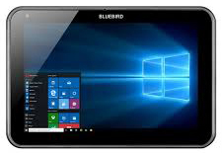
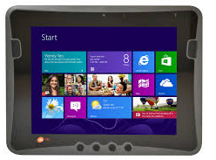
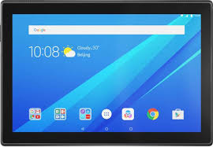
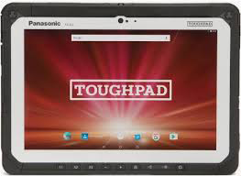
Android Competitive Comparison: 10-inch tablets
In the following chart, where appropriate, yellow shading indicates the best specification available for a feature. Competitive information is based on publicly available information.
Feature | Zebra ET51/ET56 | Apple iPad | Bluebird Pidion RT100 | Data Limited DLI10 | Lenovo Tab 4 10 Business | Panasonic FZ-A2* | Why it matters
Physical
Thickness | 0.5 in./12.7 mm | 0.23 in./5.9 mm | 0.57 in./14.6 mm | 0.84 in./21.5 mm | 0.33 in./8.5 mm | 0.65 in./16.5 mm | While consumer devices like the iPad Pro are much lighter and slimmer, these devices do not offer the same level of ruggedness as the ET51/ET56 and will require accessories to increase durability (and the rugged accessories add weight and thickness). The ET51/ET56 is one of the thinner and lighter enterprise-class and rugged tablets in its class.
Weight | ET51: 1.6 lbs/745.5 g | 1.03 lbs./468 g | 1.78 lbs./810 g | 2.9 lbs./1315 g | 1.11 lb./506 g | 1.94 lbs./879 g
Physical connectors | Docking connector (charge and data) Rugged connector for use with rugged dock (charge and data) USB-C side port (data only) | USB-C Connector; Smart Connector | Docking Connector; USB Host | USB 2.0, HDMI, VGA pass-through to cradle | MicroSD slot | Docking port, headphone/mic, HDMI, USB 3.0; optional USB 2.0; standalone USB 3.1 Type-C | While the ET51/ET56 may not offer the most physical connectors, it offers the most versatility and flexibility through its connectors. For example, the docking station connector allows the ET51/ET56 tablets to double as desktop solutions. A single docking station supports the ET51 and the ET56, with or without the rugged frame. And the rugged connector connects to rugged mounting cradles to enable use in forklifts and other vehicles.
* Recently discontinued, may be a future update

Slide 38
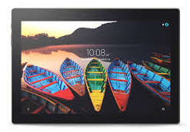
Android Competitive Comparison: 10-inch tablets
In the following chart, where appropriate, yellow shading indicates the best specification available for a feature. Competitive information is based on publicly available information.
Feature | Zebra ET51/ET56 | Apple iPad | Bluebird Pidion RT100 | Data Limited DLI10 | Lenovo Tab 4 10 Business | Panasonic FZ-A2 | Why it matters
Performance Characteristics
Operating System | Android 8.1 Oreo, upgradeable through Android R | iOS 12 | Windows 10 IoT Enterprise, Windows 8.1 Industry Pro, Android 4.4 | Android® 6 Marshmallow; Windows® 7, 8, 10 Windows Embedded 7/8; Linux Ubuntu 14 | Android 7.1 (Nougat) | Android 6.0.1 (Marshmallow) | The ET51/ET56 offers the most advanced Android operating system, and is the only device in its category to offer support for the next three releases, P, Q and R.
Processor | Qualcomm SnapdragonTM 660 octa-core 2.2 GHz | A12x | 1.83 GHz Quad Core | Intel N2930 1.8GHz Quad Core | Qualcomm Snapdragon quad-core 1.4 GHz | Intel® Atom quad-core x5-Z8550 Processor, 1.44 GHz | The ET51/ET56 offers the fastest processor in its class, providing the fastest and most robust application performance.

Slide 39
Android Competitive Comparison: 10-inch tablets
In the following chart, where appropriate, yellow shading indicates the best specification available for a feature. Competitive information is based on publicly available information.
Feature | Zebra ET51/ET56 | Apple iPad | Bluebird Pidion RT100 | Data Limited DLI10 | Lenovo Tab 4 10 Business | Panasonic FZ-A2 | Why it matters
Performance Characteristics - continued
Memory | 4GB RAM/ 32GB eMMC Flash | RAM not specified 32GB or 128GB Flash | 2GB RAM 16GB or 32GB Flash | 4GB/64GB | 2GB RAM 16GB Flash | 4GB RAM; 32GB Flash | With the most memory in this class, the ET51/ET56 can run multiple simultaneous programs without eroding performance.
Expansion | Expansion Back; MicroSDXC slot (supports up to 200 GB); USB-C port (data only) | None | Micro SDXC up to 64GB | None | Up to 128GB Micro SD | Up to 32GB Micro SDHC | Integrated connector to easily add accessories; only tablet in this class to support Micro SDXC up to 2T capacity; the USB-C port delivers maximum data transfer speeds and maximum external drive capacity — up to 256GB.

Slide 40
Android Competitive Comparison: 10-inch tablets
In the following chart, where appropriate, yellow shading indicates the best specification available for a feature. Competitive information is based on publicly available information.
Feature | Zebra ET51/ET56 | Apple iPad | Bluebird Pidion RT100 | Data Limited DLI10 | Lenovo Tab 4 10 Business | Panasonic FZ-A2 | Why it matters
Wireless Communications
WiFi | 802.11 a/b/g/n/d/h/i/k/r/ac; IPv4; IPv6; dual band 2x2 MU-MIMO for transmit and receive | 802.11 a/b/g/n/ac dual band MIMO | 802.11a/b/g/n | 802.11 a/b/g/n/ac Wi-Fi | 802.11 a/b/g/n 2.4 GHz only | 802.11a/b/g/n/ac dual band | The ET51/ET56 offers maximum WiFi performance, period. The ET51/ET56 are the only tablets in this class to support 802.11ac for the fastest WiFi speeds, 802.11r for the fastest roaming, and 2x2 MU-MIMO for increased WiFi range and performance.
Cellular | [10.1 in. tablet only available in WiFi] | GSM/EDGE, CDMA EV‑DO, UMTS/HSPA/​HSPA+/​DC‑HSDPA, LTE | GSM, GPRS, EDGE; WCDMA, HSDPA, HSUPA/HSPA+ | Optional 4G PRS/CDMA; AT&T® and T Mobile® | Optional 4G LTE | Optional 4G LTE | The ET56 is not available in a 10 inch cellular model — cellular connectivity is only offered in the ET56 8.4 inch model. If your customer requires the larger 10.1 inch display, sell Zebra’s rugged L10 tablet line.

Slide 41
Android Competitive Comparison: 10-inch tablets
In the following chart, where appropriate, yellow shading indicates the best specification available for a feature. Competitive information is based on publicly available information.
Feature | Zebra ET51/ET56 | Apple iPad | Bluebird Pidion RT100 | Data Limited DLI10 | Lenovo Tab 4 10 Business | Panasonic FZ-A2 | Why it matters
Wireless Communications - continued
Bluetooth | Bluetooth v5.0 / 2.1+EDR Class 2 (Bluetooth LE) | Bluetooth 5.0 | Bluetooth V4.0, LE | Bluetooth V4.0, LE | Bluetooth 4.0 | Bluetooth® v4.2 (Class 1) + EDR | Offers the most advanced release of Bluetooth, delivering twice the speed and four times the range with less power, compared to the prior generation of Bluetooth (v4.x). The result is better Bluetooth peripheral performance, from scanners and headsets to printers.
GPS | [10.1 in. tablet only available in WiFi – no cellular/GPS] | Assisted GPS, GLONASS, Galileo, and QZSS | S-GPS, A-GPS, GLONASS, BeiDou | GPS/ublox 7 (optional) | A-GPS; GLONASS; Beidou | GPS (optional) | The ET56 is only available in the 8.4 in. model; it is not available in the 10.1 in. model. If you have a customer that needs a rugged 10 in. screen, please see the Zebra L10 rugged tablet product line.

Slide 42
Android Competitive Comparison: 10-inch tablets
In the following chart, where appropriate, yellow shading indicates the best specification available for a feature. Competitive information is based on publicly available information.
Feature | Zebra ET51/ET56 | Apple iPad | Bluebird Pidion RT100 | Data Limited DLI10 | Lenovo Tab 4 10 Business | Panasonic FZ-A2 | Why it matters
Power
Battery | Rechargeable Li-Polymer 9660 mAh, 3.85V, (24.4 Whr) 3400 mAh, 7.2V (24.5 Wh) secondary battery (user replaceable) | Rechargeable lithium-polymer battery | 6000 mAh | 3950 mAh | 7000 mAh Up to 20 hours general usage | 2720 mAh Li-Ion Up to 9 hours | The ET51/ET56 offers the largest capacity battery in this class for maximum cycle time on a single charge, as well as the only tablet with an auxiliary user-replaceable hot-swappable battery that can provide continuous power.
User-replaceable | Yes (optional hot-swappable secondary battery) Internal battery is field replaceable | No | Yes | Yes | No | Yes | Both ET51/ET56 batteries are replaceable: the main internal battery can be replaced on site, and the auxiliary battery is user replaceable on the fly.

Slide 43
Android Competitive Comparison: 10-inch tablets
In the following chart, where appropriate, yellow shading indicates the best specification available for a feature. Competitive information is based on publicly available information.
Feature | Zebra ET51/ET56 | Apple iPad | Bluebird Pidion RT100 | Data Limited DLI10 | Lenovo Tab 4 10 Business | Panasonic FZ-A2 | Why it matters
Power
Continuous Power | Yes Second optional hot-swappable battery via Expansion Back | Up to 10 hours | Detachable/ replaceable hot swap function | Yes Integrated bridge battery offers 1 minute swap time | Up to 20 hours | Yes Bridge battery offers 1 minute swap time | The ET51/ET56 is one of the few devices in this class to offer an auxiliary user-replaceable battery (via the expansion back) — so the tablet never needs to be taken out of service to charge. This optional auxiliary battery also trickle charges the main battery. When the internal main battery is depleted, it is replaceable right at your customer’s facility, extending tablet lifecycle and reducing ROI.

Slide 44
Android Competitive Comparison: 10-inch tablets
In the following chart, where appropriate, yellow shading indicates the best specification available for a feature. Competitive information is based on publicly available information.
Feature | Zebra ET51/ET56 | Apple iPad | Bluebird Pidion RT100 | Data Limited DLI10 | Lenovo Tab 4 10 Business | Panasonic FZ-A2 | Why it matters
Data Capture
Barcode Scanning | Moderate to intensive scanning: SE4750 optional advanced imager via the expansion back accessory Occasional scanning: 13 MP high-resolution integrated camera | No (via camera only) | No | 1D/2D imager, 1D standard laser, 1D advanced long range laser | No (via camera only) | Optional 1D/2D reader | The ET51/ET56 offers one of Zebra’s industry leading scanning engines via the Expansion Back. The SE4750 delivers Zebra’s exclusive PRZM Intelligent Imaging technology for first-time, every time capture of virtually any 1D/2D barcode in any condition. (For more information on the SE4750 and its scan engine performance, please visit www.zebra.com/se4750)
Rear Camera | 13 MP | 12 MP | 5 MP | 5 MP | 5 MP | 8 MP | The ET51/ET56’s rear camera is best-in-class, providing high resolution images that are ideal for proof of condition and more.
Front Camera | 5 MP | 7 MP | 2 MP | 2 MP | 2 MP | 2 MP | The ET51/ET56 offers the highest resolution front camera for video calls that enable on-the-spot help and collaboration.

Slide 45
Android Competitive Comparison: 10-inch tablets
In the following chart, where appropriate, yellow shading indicates the best specification available for a feature. Competitive information is based on publicly available information.
Feature | Zebra ET51/ET56 | Apple iPad | Bluebird Pidion RT100 | Data Limited DLI10 | Lenovo Tab 4 10 Business | Panasonic FZ-A2 | Why it matters
Environmental
Drop Spec | 3.3 ft./1 m to concrete per MIL-STD-810G With optional rugged frame: 5.9 ft./1.8 m to concrete per MIL-STD-810G | No | 4 ft./1.2 m 5 ft./1.5 m with rugged plug | 4 ft./1.2 m to concrete | No | 5 ft./1.5 m drop; MIL-STD-810G | The optional rugged frame doubles the ET51/ET56’s concrete drop specification, providing the maximum drop specification in this product class.
Sealing | IP65 | No | IP65 | IP54 | No | IP65 | The ET51/ET56, like other rugged tablets in this class, offers IP65 sealing to protect against dust, spilled liquids and spraying water.
Operating Temperature | -4° F to 122° F/ -20° C to 50° C | 32° to 95° F 0° to 35° C | 14° to 140° F -10° to 60° C | 14°F to 122°F -10°C to 50°C | 32° to 104° F 0° to 40° C | 14°F to 122°F -10°C to 50°C | With the widest temperature range in this class, the ET51/ET56 is built to handle subzero temperatures and extreme heat.

Slide 46
Android Competitive Comparison: 10-inch tablets
In the following chart, where appropriate, yellow shading indicates the best specification available for a feature. Competitive information is based on publicly available information.
Feature | Zebra ET51/ET56 | Apple iPad | Bluebird Pidion RT100 | Data Limited DLI10 | Lenovo Tab 4 10 Business | Panasonic FZ-A2 | Why it matters
Display
Display Size/ Resolution | 10.1 in. 2650x1600 540 nit | 9.7 in. 2388x1668 600 nit | 10.1 in. 1280 x 800 | 9.7 in. 1024×768 350 nit | 10.1 in. 1280x800 350 nit | 10.1 in. IPS 1920x1200 800 nit | The ET51/ET56 offers the highest resolution display in this class.
Touch Screen Mode Options | Capacitive 10 point multi-touch; automatic support for gloves/wet display | LED-backlit multi-touch display with IPS technology | 10 point multi-touch | Touch and stylus | Capacitive 10-point multi-touch | Capacitive 10 point multi-touch; waterproof stylus; glove mode and wet-touch mode | With the advanced touch screen technology in the ET51/ET56, every input mode works, even if the display is wet. And unlike competitive devices that offer a glove and rain mode, preferred entry styles that optimize entry performance are available for all modes of entry.
Durability | Corning Gorilla Glass | Not published | Direct Bonding; Corning Gorilla Glass | None | None | Pre-installed replaceable screen film for protection | Corning Gorilla Glass protects the most vulnerable aspect of any tablet — the display — with shatter and scratch resistance.
Readability | Daylight viewable | Anti-reflective coating | Not published | LED backlit indoor/outdoor readable | Not daylight viewable (no features listed) | Daylight viewable | The ET51/ET56 offers the brightness required for easy reading in bright sunlight.

Slide 47
Android Competitive Comparison: 10-inch tablets
In the following chart, where appropriate, yellow shading indicates the best specification available for a feature. Competitive information is based on publicly available information.
Feature | Zebra ET51/ET56 | Apple iPad | Bluebird Pidion RT100 | Data Limited DLI10 | Lenovo Tab 4 10 Business | Panasonic FZ-A2 | Why it matters
Software
Value-add Software Tools | Mobility DNA: Management Tools: Enterprise Home Screen LifeGuard StageNow PowerPrecision Console WorryFree WiFi Device Tracker Enterprise Mobility Management Toolkit Productivity Tools: DataWedge Enterprise Keyboard Device Diagnostics PowerPrecision+ Swipe Assist Development Tools: Mobility Extensions (Mx) EMDK for Android Enterprise Browser | None | No software data available at this time | No software data available at this time | No software data available at this time | No software data available at this time | While some competitive devices have some software offerings, only Zebra has a comprehensive portfolio of tools that provide your customers with value they just can’t get in a competitive device. There are 15 tools and counting for the ET51/ET56 – and new Mobility DNA tools are always in the making. Of the 15 tools available today: 6 are free and pre-loaded, ready to use on the ET56/ET56 6 are free but your customers will need to download the software 3 are fee-based and downloadable

Slide 48
Android Competitive Comparison: 10-inch tablets
In the following chart, where appropriate, yellow shading indicates the best specification available for a feature. Competitive information is based on publicly available information.
Feature | Zebra ET51/ET56 | Apple iPad | Bluebird Pidion RT100 | Data Limited DLI10 | Lenovo Tab 4 10 Business | Panasonic FZ-A2 | Why it matters
Accessories
Accessories | ShareCradles (4-slot); docking stations; vehicle mount cradle (third party); single slot charge cradle; 4-slot optional battery charger; rugged frames; expansion back to easily add accessories (scanner/hand strap and optional battery bay or hand strap); passive stylus; holster; shoulder strap; charging cables and more | No enterprise-class accessories | Smart Plug Barcode/IC Card Reader/Spin handle; landscape square handle; portrait square handle; shoulder strap; rugged plug; one slot charge cradle, one slot Ethernet cradle with 3 USB ports/printer charging port (not available with Smart Plug), vehicle chargers and mounts; screen guards and more. | Desktop and vehicle cradles; 7-slot charging cradle, single bay battery charger; keyboard; scale | Rugged case, sealed case, Bluetooth keyboard; charging cables | Single slot desktop cradle; standard, slim and extended vehicle docks; extended vehicle cradle; hand strap; rotating hand strap; stylus; 4 slot battery charger, standard battery | The ET51/ET56 tablets offer the most accessories in this class for the most flexibility, with accessories that improve ruggedness, expand use cases (for example, in forklifts or as desktop replacements), increase carrying options, and more.

Slide 49
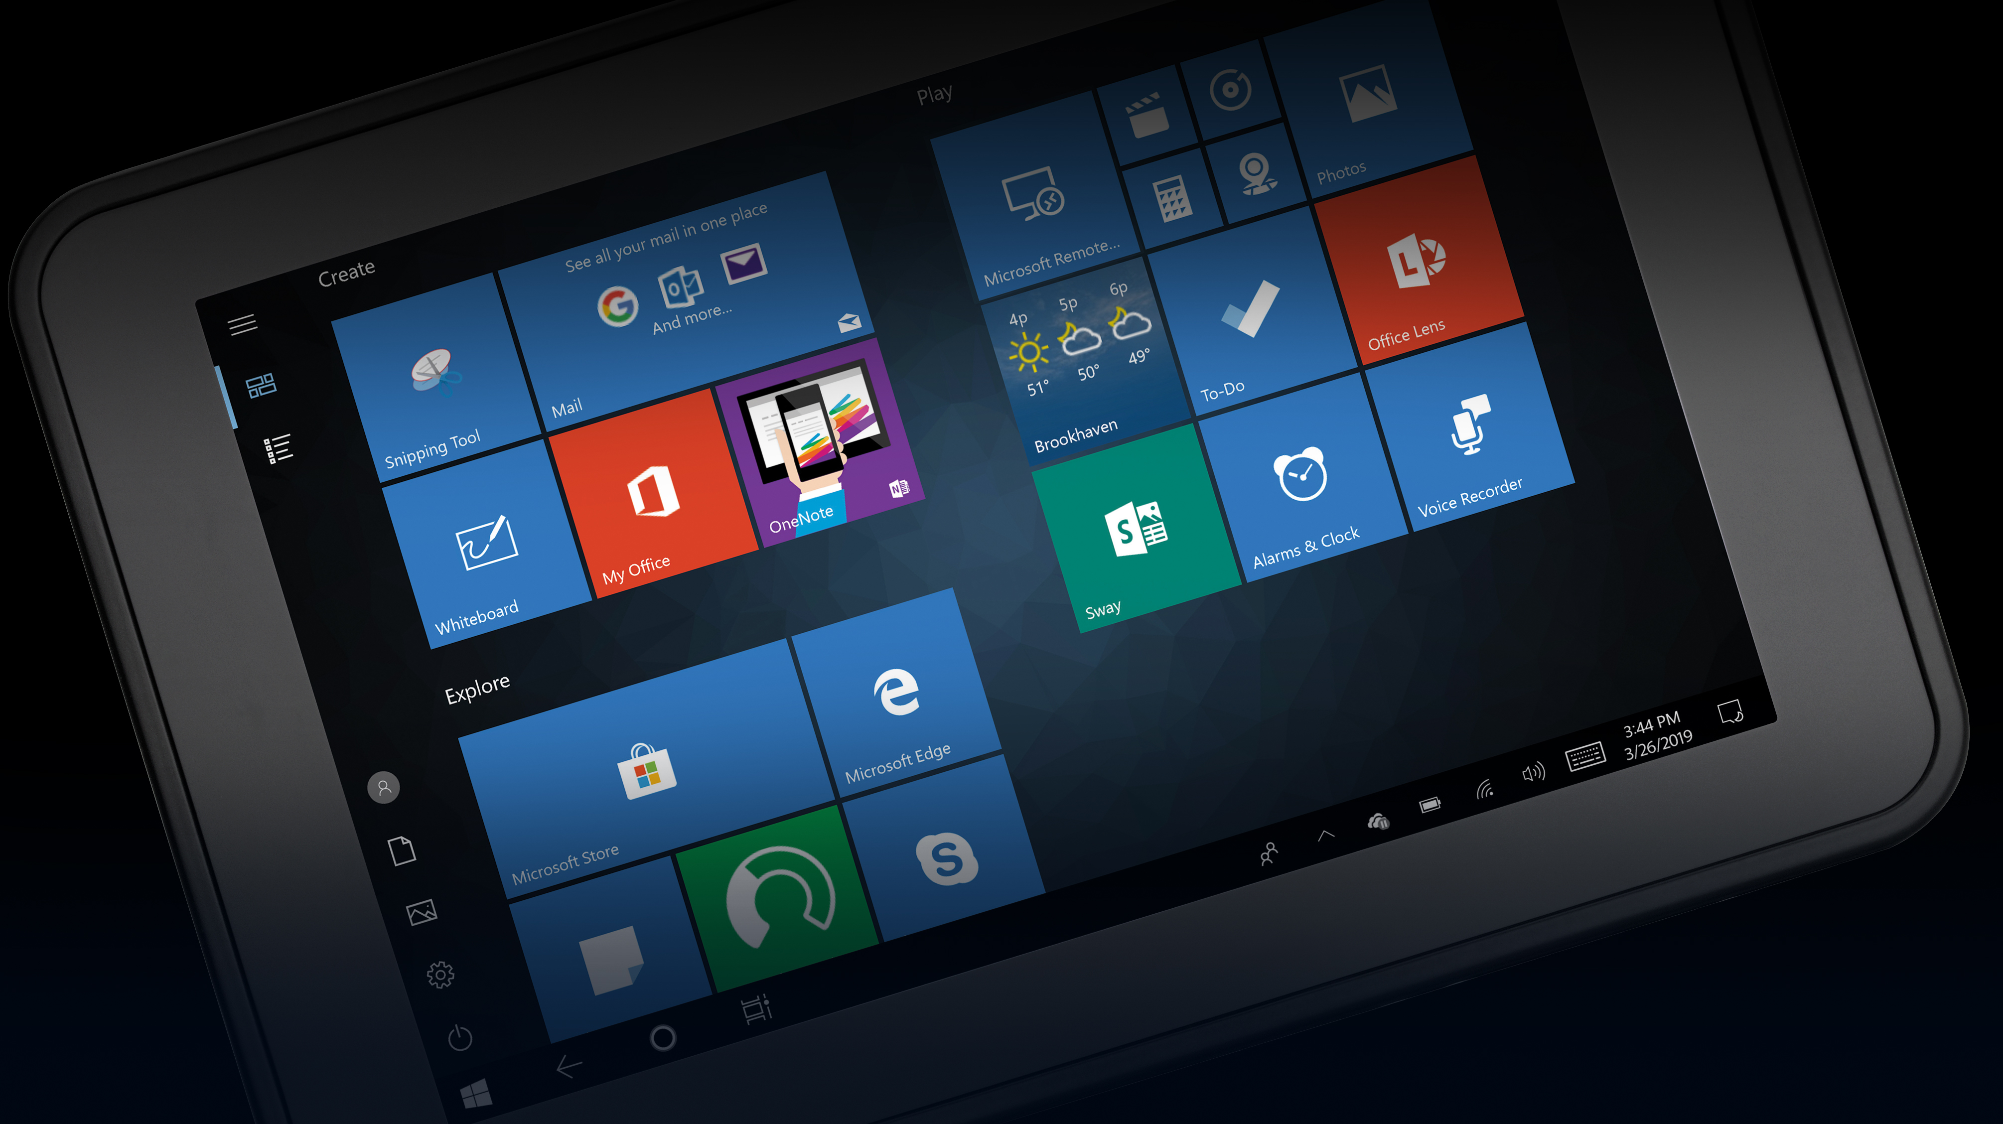
Individual Fight Sheets: 8-inch Windows Competitors
49

Slide 50
Windows Fight Sheet
Apple iPad Mini
KEY Weaknesses
Less memory ─ half the RAM and Flash of ET51/ET56
No expandable memory
Battery is not user replaceable; no hot swap or continuous power; devices must be taken out of service in order to charge the battery
No enterprise scanning; barcode scanning is performed via the camera ─ built for light scanning applications only
Not rugged: no sealing, smaller operating temperature range, no drop spec
Smaller display and inferior touch screen technology (doesn’t work when wet)
Display is less durable ─ no Gorilla Glass
Inferior accessory ecosystem: not built for the enterprise
Shorter consumer product lifecycle
Only one OS choice — iOS
KEY strengths
Thinner and lighter
50

Slide 51
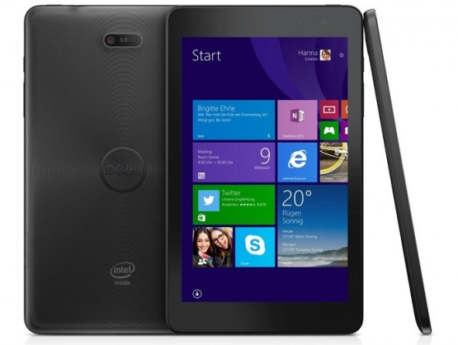
Windows Fight Sheet
Dell Venue Pro 5855
KEY Weaknesses
Inferior WiFi: no MIMO
Battery is not user replaceable; no hot swap or continuous power; devices must be taken out of service in order to charge the battery
Not rugged: no sealing, doesn’t specify operating temperature range, no drop spec
No enterprise scanning; barcode scanning is performed via the camera ─ built for light scanning applications only
Lower resolution rear camera (5MP vs. 8MP)
Harder to read in bright sunlight
Display is less durable ─ no Gorilla Glass
Inferior accessory ecosystem
KEY strengths
Thinner and lighter
51

Slide 52
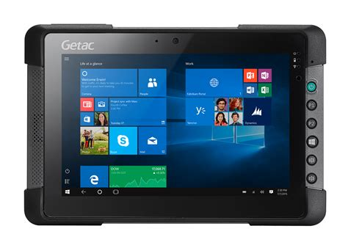
Windows Fight Sheet
Getac T800
KEY Weaknesses
Heavier and nearly twice as thick; more cumbersome to carry throughout a full shift
Inferior WiFi: no MIMO
Primary battery is not user replaceable
No enterprise scanning; barcode scanning is performed via the camera ─ built for light scanning applications only
Display is less durable ─ no Gorilla Glass
Inferior accessory ecosystem
KEY strengths
Rugged design
52

Slide 53
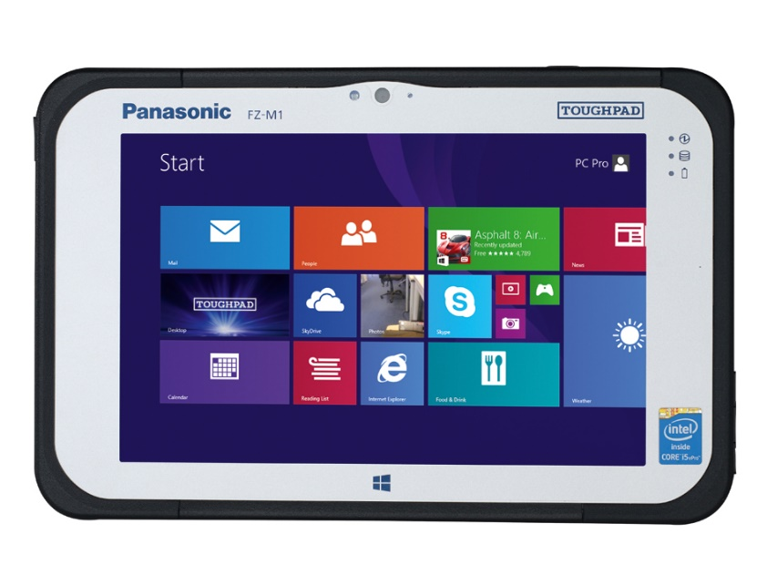
Windows Fight Sheet
Panasonic FZ-M1
KEY Weaknesses
Thicker and heavier; more cumbersome to carry throughout a full shift
Inferior WiFi: no MIMO
Batteries are hard to replace with the handstrap on
Inferior barcode scanning performance
Display is less durable ─ no Gorilla Glass
Inferior accessory ecosystem
Inferior ergonomics: heavier and thicker
Smaller 7 in. display — less real estate to display application screens, potentially requiring scrolling to access needed information
KEY strengths
Rugged design
53

Slide 54
Individual Fight Sheets: 10-inch Windows Competitors
54

Slide 55
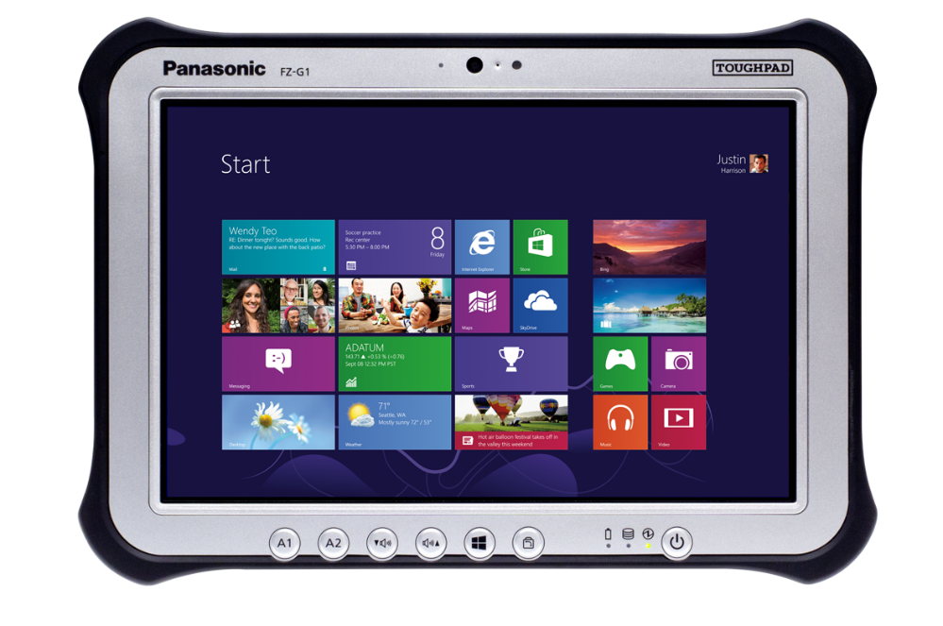
Windows Fight Sheet
Panasonic FZ-G1
KEY Weaknesses
Thicker and heavier; more cumbersome to carry throughout a full shift
Inferior WiFi: no 802.11r/k/v
Batteries have been recalled over fire hazard
Batteries are hard to replace with the handstrap on
Inferior barcode scanning performance
Display is less durable ─ no Gorilla Glass
Inferior accessory ecosystem
Severely limited expandability
KEY strengths
HazLoc model
Infrared camera option
55

Slide 56
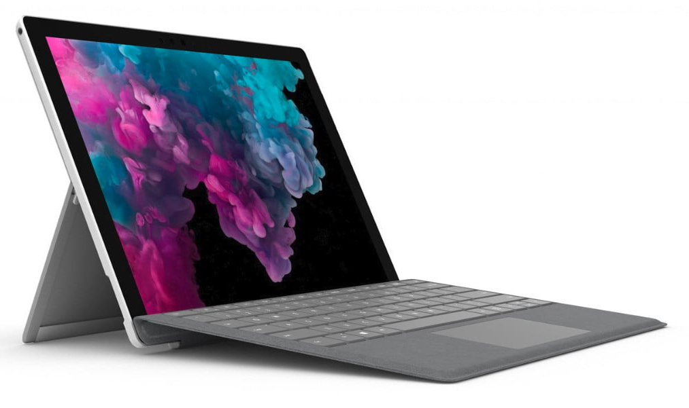
Windows Fight Sheet
Microsoft Surface Pro 6
KEY Weaknesses
Inferior WiFi: no MIMO
Battery is not user replaceable; no hot swap or continuous power; devices must be taken out of service in order to charge the battery
Not rugged: no sealing, doesn’t specify operating temperature range, no drop spec
No enterprise scanning; barcode scanning is performed via the camera ─ built for light scanning applications only
No cellular option; customers must purchase Surface Pro 2017 LTE
Display is less durable ─ no Gorilla Glass
Inferior accessory ecosystem
KEY strengths
Thinner and lighter
Higher resolution front camera
56

Slide 57
Windows Fight Sheet
Apple iPad
KEY Weaknesses
Less standard RAM
No expandable memory
Battery is not user replaceable; no hot swap or continuous power; devices must be taken out of service in order to charge the battery
Not rugged: no sealing, smaller operating temperature range (only goes down to 32˚F), no drop spec
No enterprise scanning; barcode scanning is performed via the camera ─ built for light scanning applications only
Display is less durable ─ no Gorilla Glass
Inferior accessory ecosystem
Shorter consumer product lifecycle
Only one OS choice — iOS
KEY strengths
Thinner and lighter
57

Slide 58
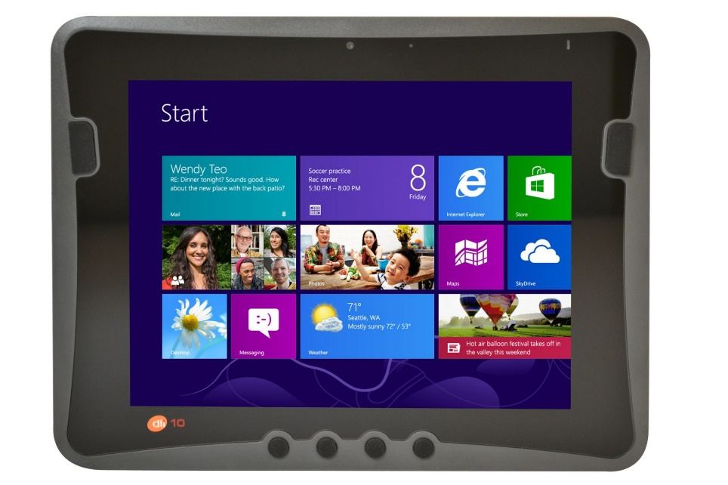
Windows Fight Sheet
Digital Limited DLI10
KEY Weaknesses
Thicker and heavier; more cumbersome to carry throughout a full shift
Inferior WiFi: no MIMO
Lower capacity battery
No expandable memory
Limited cellular coverage (only supports AT&T and T-Mobile)
Lower resolution rear camera
Less rugged: lower sealing, smaller operating temperature range (only goes down to 14˚F)
Display is less durable ─ no Gorilla Glass
Display is not as bright (350 nit vs. 540 nit)
KEY strengths
Optional 8MB RAM; onboard SSD memory options up to 256 GB (but no memory card)
58

Slide 59
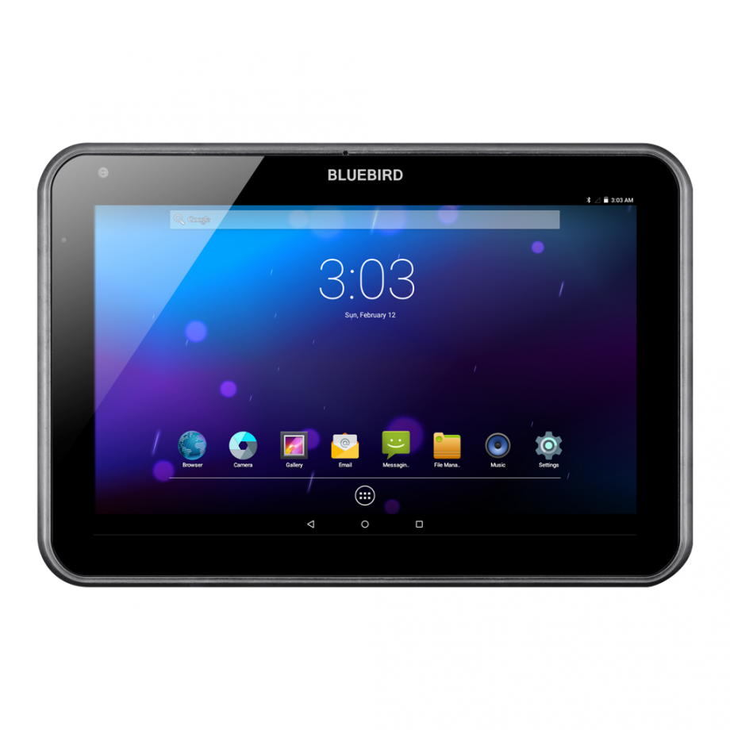
Windows Fight Sheet
Bluebird Pidion RT100
KEY Weaknesses
Slightly heavier and thicker
Inferior WiFi: no 802.11ac or MIMO
Less memory: half the RAM and a quarter of the Flash memory
No expandable memory
Lower resolution rear camera
Lower resolution display
Less rugged: only 5 ft./1.5 m drop spec with rugged accessory
KEY strengths
Faster processor
59

Slide 60
Competitive Feature-to-Feature Comparison Charts: 8-inch Windows Competitors
60

Slide 61
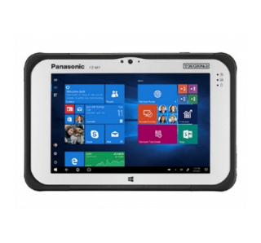
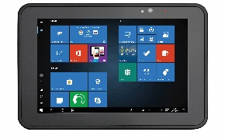
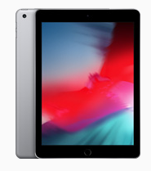
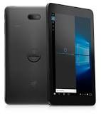
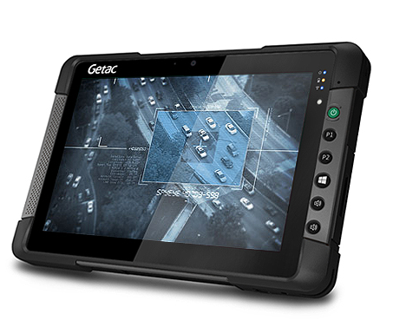
Windows Competitive Comparison: 8-inch tablets
In the following chart, where appropriate, yellow shading indicates the best specification available for a feature. Competitive information is based on publicly available information.
Feature | Zebra ET51/ET56 | Apple iPad Mini | Dell Venue 8 Pro 5855 | Getac T800 | Panasonic FZ-M1 | Why it matters
Physical
Thickness | 12.7 mm | 6.1 mm | 9.45 mm | 24 mm | 18 mm | While consumer devices like the iPad and Dell Venue are much lighter and slimmer, these devices do not offer the same level of ruggedness as the ET51/ET56 and will require accessories to increase durability (and the rugged accessories add weight and thickness).
Weight | 1.26 lbs./570 g | WiFi only: 0.65 lbs./298.8 g WiFi/Cellular: 0.67/304 g | 0.83 lbs./377 g | 1.94 lbs./880 g | 1.27 lbs./576 g
Physical connectors | Docking connector: USB-C; rugged connector for use with rugged dock interfaces | Lightning connector, 3.5 mm audio | 3.5 mm audio | DC, USB 3.0, docking port, headphone/mic, Micro HDMI | Docking port, headphone/mic, USB 3.0, optional Ethernet, optional USB 2.0 | With the docking station, the ET51/ET56 offers all the connectivity needed to use it as a desktop solution – and there’s even a single docking station that supports the ET51 and the ET56, with or without the rugged frame.

Slide 62
Windows Competitive Comparison: 8-inch tablets (continued)
In the following chart, where appropriate, yellow shading indicates the best specification available for a feature. Competitive information is based on publicly available information.
Feature | Zebra ET51/ET56 | Apple iPad Mini | Dell Venue 8 Pro 5855 | Getac T800 | Panasonic FZ-M1 | Why it matters
Performance Characteristics
Operating System | Windows 10 IoT Enterprise | iOS 12 | Windows 10 Pro | Windows 10 Pro | Windows 10 Pro | Windows 10 IoT Enterprise offers limited forced OS updates, 10 yrs support for each update; contains only the essential Windows components to reduce the footprint on the tablet — without reducing functionality.
Processor | Intel Atom E3940 quad core 1.6 GHz (turbo frequency = 1.8 GHz) | A10 Fusion | Intel Atom Z8500 Quad core 1.44 GHz base frequency (2.24 GHz burst frequency | Intel Atom Z8700 1.6 GHz /2.4 GHz | Intel® Core m5-6Y57 (2.8 GHz / 2.3 GHz) | The ET51/ET56’s quad core Atom E3940 processor has greater memory bandwidth for better performance in memory bound applications.
Memory | 4GB RAM, 64GB Flash | 2GB RAM, 32GB Flash | 4GB RAM, 64GB Flash | 4GB RAM, 64GB Flash | 8GB RAM, 256GB Flash | Plenty of capacity to run your programs and store your data.
Expansion | micro SDXC up to 2TB | No | microSD up to 128GB | Expansion available | Micro SDXC, UHS-I | The ET51/ET56 supports the most expandable memory in this class.

Slide 63
Windows Competitive Comparison: 8-inch tablets (continued)
In the following chart, where appropriate, yellow shading indicates the best specification available for a feature. Competitive information is based on publicly available information.
Feature | Zebra ET51/ET56 | Apple iPad Mini | Dell Venue 8 Pro 5855 | Getac T800 | Panasonic FZ-M1 | Why it matters
Wireless Communication
WiFi | 802.11a/b/g/n/ac/r/k/v dual band 2x2 MIMO | 802.11 a/b/g/n/ac dual band MIMO | 802.11a/b/g/n/ac | 802.11ac | 802.11a/b/g/n/ac dual band | While all devices in this class support 802.11ac, the ET51/ET56 is one of the few to support 2x2 MIMO, which increases WiFi range and performance. In addition, the ET51/ET56 supports industry-standard 802.11r fast roaming.
Cellular | ET56 only: Global LTE AT&T LTE Verizon LTE | GSM/EDGE, CDMA EV‑DO, UMTS/HSPA/​HSPA+/​DC‑HSDPA, LTE | LTE Cat 6 | 4G LTE, XLTE ready (optional) | 4G LTE | The ET56 offers global coverage for cellular networks.
Bluetooth | V4.2, LE | V4.2, LE | V4.1, LE | V4.0 | V4.1 | Adds direct IP addressing to support IoT connectivity, expanding peripheral flexibility.
GPS | GPS, Galileo, Glonass, A-GPS | Glonass, A-GPS | No | GPS (optional) | GPS (optional) | The ET51/ET56 supports the most options for autonomous and assisted GPS, providing connectivity in more locations and challenging areas, improving locationing accuracy and application performance.

Slide 64
Windows Competitive Comparison: 8-inch tablets (continued)
In the following chart, where appropriate, yellow shading indicates the best specification available for a feature. Competitive information is based on publicly available information.
Feature | Zebra ET51/ET56 | Apple iPad Mini | Dell Venue 8 Pro 5855 | Getac T800 | Panasonic FZ-M1 | Why it matters
Power
Battery | 3300 mAh Plus optional, hot swappable 3400 mAh (24.4 Whr) auxiliary battery (via Expansion Back) | 6480 mAh Li-polymer | 4450 mAh Li-polymer | 4200 mAh Li-Ion Optional auxiliary battery (SnapBack) 2100 mAh | Standard: 3220 mAh Optional long life: 7100 mAh | While the ET51/ET56 may not offer the largest capacity battery in this class, the battery is user-replaceable and the hot-swappable second battery provides continuous power.
User-replaceable | Yes | No | No | No | Yes * Hard to replace when the handstrap is on | The ET51/ET56 is one of the few devices in this class to offer a user-replaceable battery – the tablet never needs to be taken out of service to charge.
Continuous Power | Yes Via second and optional, hot swappable 3400 mAh (24.4 Whr) auxiliary battery (in Expansion Back) | No | No | Yes Second optional 2100 mAh) SnapBack auxiliary battery | Yes Optional bridge battery enables hot swapping of the main battery in 1 minute | An optional auxiliary hot-swappable battery can be added to any ET51/ET56 Expansion Back for around-the-clock power. And this optional auxiliary battery also trickle charges the main battery.

Slide 65
Windows Competitive Comparison: 8-inch tablets (continued)
In the following chart, where appropriate, yellow shading indicates the best specification available for a feature. Competitive information is based on publicly available information.
Feature | Zebra ET51/ET56 | Apple iPad Mini | Dell Venue 8 Pro 5855 | Getac T800 | Panasonic FZ-M1 | Why it matters
Data Capture
Barcode Scanning | Enterprise-class 1D/2D scanning via expansion back accessories (Zebra SE4750 or SE4710 scan engines) | No (via camera only) | No (via camera only) | No (via camera only) | Optional 1D/2D reader | The ET51/ET56 offers Zebra’s industry-leading scanning technology via the Expansion Back. These scan engines support Zebra’s exclusive PRZM Intelligent Imaging technology for first-time, every time capture of virtually any 1D/2D barcode in any condition.
Rear Camera | 8MP | 8MP | 5MP | Optional: 8MP | 8MP | The ET51/ET56’s rear camera is on par with the market for this device class.
Front Camera | 2MP | 1.2MP | 2MP | Yes, full HD Optional FHD | 2MP | Like other devices in this class, the ET51/ET56 supports a front camera for video calls for on-the-spot help and collaboration.

Slide 66
Windows Competitive Comparison: 8-inch tablets (continued)
In the following chart, where appropriate, yellow shading indicates the best specification available for a feature. Competitive information is based on publicly available information.
Feature | Zebra ET51/ET56 | Apple iPad Mini | Dell Venue 8 Pro 5855 | Getac T800 | Panasonic FZ-M1 | Why it matters
Environmental
Drop Spec | 3.28 ft./1 m drop to concrete per MIL-STD-810G 5.9 ft./1.8 m drop to concrete with optional rugged frame | No | No | 6 ft./1.8m | 5 ft./1.5 m per MIL-STD-810G | The optional rugged frame doubles the ET51/ET56’s concrete drop specification.
Sealing | IP65 | No | No | IP65 | IP65 | The ET51/ET56, like other rugged tablets in this class, offers IP65 sealing to protect against dust, spilled liquids and spraying water.
Operating Temp. | -4° to 122° F (-20° to 50° C) | 32° to 95° F (0° to 35° C) | 32°F to 95 °F 0°C to 35 °C | -5.8° to 122° F (-21° to 50° C) | 14°F to 122 °F -10°C to 50 °C | The ET51/ET56 is built to handle subzero temperatures and extreme heat.

Slide 67
Windows Competitive Comparison: 8-inch tablets (continued)
In the following chart, where appropriate, yellow shading indicates the best specification available for a feature. Competitive information is based on publicly available information.
Feature | Zebra ET51/ET56 | Apple iPad Mini | Dell Venue 8 Pro 5855 | Getac T800 | Panasonic FZ-M1 | Why it matters
Display
Display Size/ Resolution | 8.4 in. WXGA Supports up to 2560x1600 720 nit Capacitive 10 point multi-touch | 7.9 in. 2048x1536 | 8.0 in. WXGA 1920x1200 | 8.1 in. 1280x800 600 nit Multi-touch | 7 in. 1280x800 700 nit Capacitive 10-point multi-touch | The ET51/ET56 offers the largest and brightest display in this class.
Touch Screen Mode Options | Touch only, touch and glove, passive stylus (all modes work when wet) | Not specified | Not specified | Touch and rain, glove, pen, optional digitizer mode | Pen only, pen and touch, touch only, touch only-glove, touch only-water | With the advanced touchscreen technology in the ET51/ET56, every input mode works if the display is wet.
Durability | Corning Gorilla Glass | None | Not specified | LumiBond 2.0 | Pre-installed replaceable screen film for protection | Corning Gorilla Glass, available only on the ET51/ET56, provides shatter and scratch resistance.
Readability | Daylight viewable | Anti-reflective coating | Not specified | LumiBond 2.0 sunlight readable | Daylight viewable | The ET51/ET56 offers class-best brightness and is the easiest to read in bright sunlight.

Slide 68
Windows Competitive Comparison: 8-inch tablets (continued)
In the following chart, where appropriate, yellow shading indicates the best specification available for a feature. Competitive information is based on publicly available information.
Feature | Zebra ET51/ET56 | Apple iPad Mini |  | Dell Venue 8 Pro 5855 | Getac T800 | Panasonic FZ-M1 |  | Why it matters
Accessories
Charging/ backroom | ShareCradle (4-slot), single slot cradle, 4-slot battery charger, rugged charge connector | USB charger | Single power adapter, single slot cradle |  | Single power adapter, single slot cradle |  | Single charge adapter, single slot cradle, 4-slot battery charger | Purpose built for enterprise applications, the ET51/ET56 offers the most charging options in this class. The unique ShareCradle provides space and cost efficiencies in the backroom by providing a common base to charge all Zebra mobile computers and tablets.
Docking Stations | Single-slot standard and rugged, docking only or with communications (USB, display and more) | Third-party docking stations | Single slot |  | Single slot |  | Single slot; full and lite versions | Only the ET51/ET56 offers a docking station for the tablet inside the rugged frame.

Slide 69
Windows Competitive Comparison: 8-inch tablets (continued)
In the following chart, where appropriate, yellow shading indicates the best specification available for a feature. Competitive information is based on publicly available information.
Feature | Zebra ET51/ET56 | Apple iPad Mini | Dell Venue 8 Pro 5855 | Getac T800 | Panasonic FZ-M1 | Why it matters
Accessories (continued)
Expansion | Yes Expansion Back: Scanner/handstrap Optional battery Handstrap | No | No | Yes SnapBack: SnapBack battery RFID reader SmartCard reader | No | The ET51/ET56 supports three different expansion backs to easily add new features: rotating handstrap, the SE4710 or SE4750 scan engine; plus the optional hot swappable battery.
Rugged | Rugged frame with rugged IO included: 6 ft./1.8 drops to concrete | Third-party rugged cases | No | No | Yes: ToughMate Always-on, Holster and Portfolio cases | With the rugged frame, the ET51/ET56 offers the most rugged drop specification in this class.
Carrying | Handstrap, Breakaway shoulder strap (with or without rugged frame) | Third-party carrying case with strap | Bag | Bag, shoulder strap, handstrap, wrist tether | Handstrap and rotating handstrap with stylus holder; shoulder strap; MSR handstrap | With the ET51/ET56, one flexible case provides workers with three wearable options: belt holster, over the shoulder or cross-body; breakaway strap for safety.
Vehicle | Vehicle mount cradle (third-party) and chargers | Lightning car charger; third-party vehicle mounts | Vehicle charger | Vehicle mount cradles (1 3rd party, 1 Getac); 3rd party vehicle chargers | Vehicle mount cradles (third-party) and vehicle chargers | Third-party vehicle cradles and chargers are available for cars, trucks and forklifts.

Slide 70
Competitive Feature-to-Feature Comparison Charts: 10-inch Windows Competitors
70

Slide 71
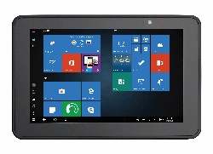
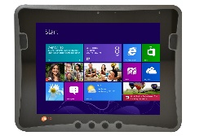
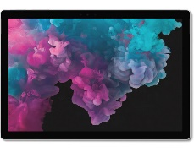
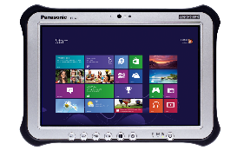
Windows Competitive Comparison: 10-inch tablets
In the following chart, where appropriate, yellow shading indicates the best specification available for a feature. Competitive information is based on publicly available information.
Feature | Zebra ET51/ET56 | Apple iPad | Bluebird Pidion RT100 | Data Limited DLI10 | Microsoft Surface Pro 6 | Panasonic FZ-G1 | Why it matters
Physical
Thickness | 0.5 in./12.7 mm | 0.29 in./ 7.5 mm | 0.59 in./14.9 mm | 0.84 in./21.5 mm | 0.33 in./8.5 mm | 0.8 in./20 mm | While consumer devices like the iPad and Microsoft Surface Pro are much lighter and slimmer, these devices do not offer the same level of ruggedness as the ET51/ET56 and will require accessories to increase durability (and the rugged accessories add weight and thickness).
Weight | 1.69 lbs./765 g | 1.05 lbs./ 478 g | 1.75 lbs../810 g | 2.56 lbs./1162 g | I5: 1.7 lbs./770 g I7: 1.73 lbs./784 g | Standard battery: 2.4 lbs./1088 g Long life battery: 2.9 lbs./1315 g
Physical connectors | Docking connector: USB-C; rugged connector for use with rugged dock interfaces | Lightning | Docking port only | USB 3.0, HDMI, Pass-through to cradle | USB 3.0, 3.5 mm audio, Mini DisplayPort, Surface Connect port | Docking port, headphone/mic, HDMI, USB 3.0, optional Ethernet | With the docking station, the ET51/ET56 offers all the connectivity needed to use it as a desktop solution.

Slide 72
Windows Competitive Comparison: 10-inch tablets (continued)
In the following chart, where appropriate, yellow shading indicates the best specification available for a feature. Competitive information is based on publicly available information.
Feature | Zebra ET51/ET56 | Apple iPad | Bluebird Pidion RT100 | Data Limited DLI10 | Microsoft Surface Pro 6 | Panasonic FZ-G1 | Why it matters
Performance Characteristics
Operating System | Windows 10 IoT Enterprise | iOS 12 | Windows 10 IoT Enterprise, Windows 8.1 Industry Pro, Android 4.4 | Windows 7, Windows 8.1, Windows 10 | Windows 10 Pro | Windows 10 Pro | Windows 10 IoT Enterprise offers limited forced OS updates, 10 yrs support for each update; contains only the essential Windows components to reduce the footprint on the tablet — without reducing functionality.
Processor | Intel Atom E3940 quad core 1.6 GHz (turbo frequency = 1.8 GHz) | A12x | 1.83 GHz Quad Core | Intel N2930 1.8GHz Quad Core | Intel Core i5-8350U or Intel Core i7-8650U | Intel Core i5-7300U 2.6 GHz (3.5 GHz with turbo boost) Intel Core i7-7600U 2.8 GHz (3.9 GHz with turbo boost) | The ET51/ET56’s quad core Atom E3940 processor has greater memory bandwidth for better performance in memory bound applications.

Slide 73
Windows Competitive Comparison: 10-inch tablets (continued)
In the following chart, where appropriate, yellow shading indicates the best specification available for a feature. Competitive information is based on publicly available information.
Feature | Zebra ET51/ET56 | Apple iPad | Bluebird Pidion RT100 | Data Limited DLI10 | Microsoft Surface Pro 6 | Panasonic FZ-G1 | Why it matters
Performance Characteristics (continued)
Memory | 4GB RAM, 64GB Flash | RAM not specified 32GB or 128GB Flash | 2GB RAM 16GB or 32GB Flash | 4GB or 8GB RAM 64GB, 128GB, or 256GB microSata SSD | 8GB or 16GB RAM 128GB, 256GB, 512GB, or 1TB SSD | 8GB RAM, 256GB* SSD (512GB,1TB option) | The ET51/ET56 does not lead the class when it comes to memory, but offers plenty of memory to run multiple apps simultaneously.
Expansion | Micro SDXC up to 2TB | No | No | No | Micro SDXC | Optional Micro SDXC | The ET51/ET56 supports up to 2TB expandable memory.

Slide 74
Windows Competitive Comparison: 10-inch tablets (continued)
In the following chart, where appropriate, yellow shading indicates the best specification available for a feature. Competitive information is based on publicly available information.
Feature | Zebra ET51/ET56 | Apple iPad | Bluebird Pidion RT100 | Data Limited DLI10 | Microsoft Surface Pro 6 | Panasonic FZ-G1 | Why it matters
Wireless Communication
WiFi | 802.11a/b/g/n/ac/r/k/v dual band 2x2 MIMO | 802.11 a/b/g/n/ac dual band MIMO | 802.11a/b/g/n | 802.11a/b/g/n/ac dual band | 802.11a/b/g/n/ac dual band | 802.11a/b/g/n/ac dual band | The ET51/ET56 is one of the few devices in this class to support 2x2 MIMO, which increases WiFi range and performance. In addition, the ET51/ET56 supports industry-standard 802.11r fast roaming.
Cellular | ET56 only: Global LTE AT&T LTE Verizon LTE | GSM/EDGE, CDMA EV‑DO, UMTS/HSPA/​HSPA+/​DC‑HSDPA, LTE | UMTS/HSDPA/HSUPA/HSPA/HSPA+, GSM/GPRS/EDGE | 4G PRS/CDMA (AT&T, T-Mobile) | No | Optional 4G LTE | The ET56 offers global coverage for cellular networks.
Bluetooth | V4.2, LE | V4.2, LE | V4.0, LE | V4.0, LE | V4.1 | V4.2, LE | All devices in this class support comparable Bluetooth standards.
GPS | GPS, Galileo, Glonass, A-GPS | GPS, Glonass | A-GPS, GLONASS | GPS/ublox 7 (optional) | No | GPS (optional) | The ET51/ET56 supports the most options for autonomous and assisted GPS, providing connectivity in more locations and challenging areas, improving locationing accuracy and application performance.

Slide 75
Windows Competitive Comparison: 10-inch tablets (continued)
In the following chart, where appropriate, yellow shading indicates the best specification available for a feature. Competitive information is based on publicly available information.
Feature | Zebra ET51/ET56 | Apple iPad | Bluebird Pidion RT100 | Data Limited DLI10 | Microsoft Surface Pro 6 | Panasonic FZ-G1 | Why it matters
Power
Battery | 4950 mAh | Size not specified | 6000 mAh | 3950 mAh | Capacity not specified | Std.: 4200 mAh Long life: 9300 mAh (*batteries have been recalled over fire hazard) | While the ET51/ET56 may not offer the largest capacity battery in this class, the battery is user-replaceable and the hot-swappable second battery provides continuous power.
User-replaceable | Yes | No | Yes | Yes | No | Yes | The ET51/ET56 supports a user-replaceable battery – the tablet never needs to be taken out of service to charge.
Continuous Power | Yes Second optional hot-swappable battery via Expansion Back | No | Detachable/ replaceable hot swap function | Yes Integrated bridge battery offers 1 minute swap time | No | Yes Bridge battery offers 1 minute swap time | An optional hot-swappable battery can be added to any ET51/ET56 Expansion Back for around-the-clock power. And since the expansion back auxiliary battery trickle charges the main battery, there is no need for a bridge battery, such as the one in the DL10 or Panasonic FZ-G1.

Slide 76
Windows Competitive Comparison: 10-inch tablets (continued)
In the following chart, where appropriate, yellow shading indicates the best specification available for a feature. Competitive information is based on publicly available information.
Feature | Zebra ET51/ET56 | Apple iPad | Bluebird Pidion RT100 | Data Limited DLI10 | Microsoft Surface Pro 6 | Panasonic FZ-G1 | Why it matters
Data Capture
Barcode Scanning | Enterprise-class 1D/2D scanning via expansion back accessories (Zebra SE4750 and SE4710 scan engines) | No (via camera only) | 1D/2D imager (smart plug option) | 1D/2D imager, 1D standard laser, 1D advanced long range laser | No (via camera only) | Optional 1D/2D reader | The ET51/ET56 offers Zebra’s industry-leading scanning technology via the expansion back. These scan engines support Zebra’s exclusive PRZM Intelligent Imaging technology for first-time, every time capture of virtually any 1D/2D barcode in any condition.
Rear Camera | 8MP | 8MP | 5MP | 5MP | 8MP | 8MP | The ET51/ET56’s rear camera is on par with the market for this device class.
Front Camera | 2MP | 1.2MP | 2MP | 2MP | 5MP | 2MP | Like other devices in this class, the ET51/ET56 supports a front camera for video calls for on-the-spot help and collaboration.

Slide 77
Windows Competitive Comparison: 10-inch tablets (continued)
In the following chart, where appropriate, yellow shading indicates the best specification available for a feature. Competitive information is based on publicly available information.
Feature | Zebra ET51/ET56 | Apple iPad | Bluebird Pidion RT100 | Data Limited DLI10 | Microsoft Surface Pro 6 | Panasonic FZ-G1 | Why it matters
Display
Display Size/ Resolution | 10.1 in. Supports up to 2650x1600 540 nit Capacitive 10 point multi-touch | 9.7 in. 2048x1536 | 10.1 in. 1280 x 800 | 9.7 in. 1024×768 350 nit Projective capacitive | 12.3 in. 2736x1824 10 point multi-touch | 10.1 in. 1920x1200 2-800 nit, IPS Capacitive 10 point multi-touch | The ET51/ET56 offers one of the brightest displays in this class.
Touch Screen Mode Options | Touch only, touch and glove, passive stylus (all modes work when wet) | Supports Apple Pencil | Not specified | Touch and stylus | Not specified | Bare-hand touch and gestures; electronic, waterproof stylus pen; glove mode and wet-touch mode | With the advanced touchscreen technology in the ET51/ET56, every input mode works if the display is wet.
Durability | Corning Gorilla Glass | None | Corning Gorilla Glass | None | None | Pre-installed replaceable screen film for protection | Corning Gorilla Glass provides shatter- and scratch-resistance.
Readability | Daylight viewable | Anti-reflective coating | Not specified | Outdoor readable | Not specified | Daylight viewable | The ET51/ET56 offers class-best brightness and is the easiest to read in bright sunlight.

Slide 78
Windows Competitive Comparison: 10-inch tablets (continued)
In the following chart, where appropriate, yellow shading indicates the best specification available for a feature. Competitive information is based on publicly available information.
Feature | Zebra ET51/ET56 | Apple iPad | Bluebird Pidion RT100 | Data Limited DLI10 | Microsoft Surface Pro 6 | Panasonic FZ-G1 | Why it matters
Environmental
Drop Spec | 3.28 ft./1 m drop to concrete) per MIL-STD-810G 5.9 ft./1.8 m drop to concrete with optional rugged frame | No | 4 ft./1.2 m 5 ft./1.5 m with Rugged Plug | 4 ft./1.2 m to concrete | None | 4 ft./1.2 m per MIL-STD-810G | The optional rugged frame doubles the ET51/ET56’s concrete drop specification.
Sealing | IP65 | No | IP65 | IP54 | None | IP65 | The ET51/ET56, like other rugged tablets in this class, offers IP65 sealing to protect against dust, spilled liquids and spraying water.
Operating Temp. | -4° to 122° F (-20° to 50° C) | 32° to 95° F (0° to 35° C) | Not specified | 14°F to 122°F (-10°C to 50°C) | Not specified | 14°F to 122°F -10°C to +50°C | With the widest temperature range in this class, the ET51/ET56 is built to handle subzero temperatures and extreme heat.

Slide 79
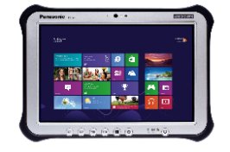
Windows Competitive Comparison: 10-inch tablets (continued)
In the following chart, where appropriate, yellow shading indicates the best specification available for a feature. Competitive information is based on publicly available information.
Feature | Zebra ET51/ET56 | Apple iPad | Bluebird Pidion RT100 | Data Limited DLI10 | Microsoft Surface Pro 6 | Panasonic FZ-G1 | Why it matters
Accessories
Charging/ backroom | ShareCradle (4-slot), single slot cradle, 4-slot battery charger, rugged charge connector | USB charger | Single slot cradle | 7-bay charging cradle, single slot cradle, single-slot battery charger | Single charger, single slot cradle | Single charge adapter, single battery charger, 3-slot battery charger | Purpose built for enterprise applications, the ET51/ET56 offers the most charging options in this class. The unique ShareCradle provides space and cost efficiencies in the backroom by providing a common base to charge all Zebra mobile computers and tablets.
Docking Stations | Single-slot standard and rugged, docking only or with communications (USB, display and more) | Third-party docking stations | Yes Single slot | Yes Single slot | Yes Single slot | Yes Single slot | Only the ET51/ET56 offers a docking station for the tablet inside the rugged frame.
Expansion | Yes Expansion Back: Scanner/handstrap Optional battery Handstrap | No | Yes Smart Plug: 1D/2D scanner IC card reader Spin handle | No | No | No | The ET51/ET56 supports three different expansion backs to easily add new features: rotating handstrap, the SE4710 or SE4750 scan engine (and the optional hot swappable battery can be added to any expansion back).

Slide 80
Windows Competitive Comparison: 10-inch tablets (continued)
In the following chart, where appropriate, yellow shading indicates the best specification available for a feature. Competitive information is based on publicly available information.
Feature | Zebra ET51/ET56 | Apple iPad | Bluebird Pidion RT100 | Data Limited DLI10 | Microsoft Surface Pro 6 | Panasonic FZ-G1 | Why it matters
Accessories (continued)
Rugged | Rugged frame with rugged IO included: 6 ft./1.8 drops to concrete | Third-party rugged cases | Rugged plug: 5 ft./1.5 m drop | No | Rugged case: “military drop specifications” | Tall corner guard set; Always-on and Professional Portfolio cases; handstrap | With the rugged frame, the ET51/ET56 offers the most rugged drop spec in this class.
Carrying | Handstrap, Breakaway shoulder strap (with or without rugged frame) | Third-party carrying case with strap | Square handle Spin handle | Not specified | Various bags and sleeves | Rotating handstrap, tether, portfolio | With the ET51/ET56, one flexible case provides workers with three wearable options: belt holster, over the shoulder or cross-body.
Vehicle | Vehicle mount cradle (third-party) | Lightning car charger; third-party vehicle mounts | None specified | Vehicle mount cradle | Vehicle charger | Vehicle charger, vehicle docks (third-party) | Third-party vehicle cradles are available for cars, trucks and forklifts.

Slide 81
Sales Tools and Resources:
Android and Windows
81

Slide 82
Sales Enablement Tools
Internal Zebra Tools | Partner Tools | External Tools
Product beauty photography | Product beauty photography | Spec Sheet
Application photography | Application photography | Customer Presentation
Selling Presentation | Selling Presentation | Product Page on Zebra.com
Battle Card | Battle Card
FAQs | FAQs
Product Descriptions: short, medium, long | Product Descriptions: short, medium, long
Comparison Guide | Comparison Guide
The Source Product Page | Co-Branded Asset Tool Kit
LMS Training Modules | Partner Gateway Microsite
Solution Center updates | LMS Training Modules
Competitive Portal | Competitive Portal

