Slide 1
Zebra Healthcare Handheld Scanner Portfolio
1
ZEBRA TECHNOLOGIES

Slide 2
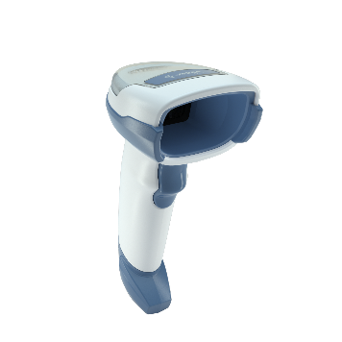
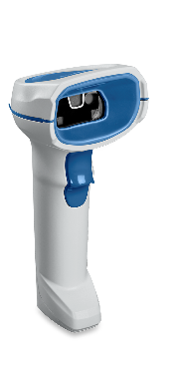
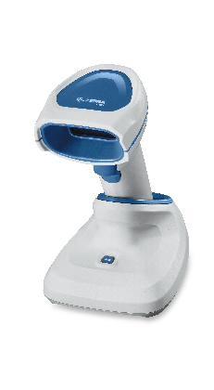
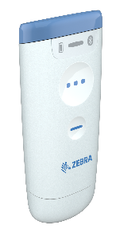
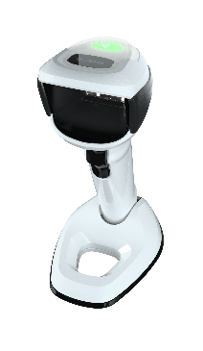
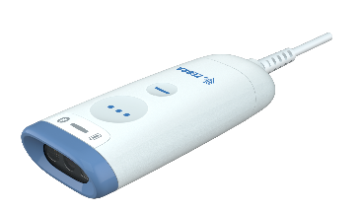
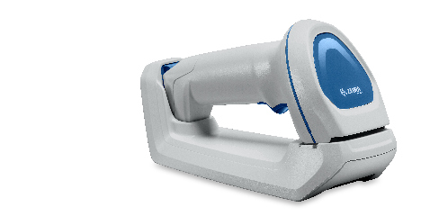
Zebra Healthcare Scanner Portfolio
CS60-HC Series
DS4600-HC Series
DS8100-HC Series
DS9900-HD Series
Corded and Cordless Convertible Companion Scanner
Corded Handheld Scanner
Corded and Cordless Handheld Scanner
Corded Hybrid Handheld/ Hands-Free Scanner
All nurse carry
Point-of-care: carts/ in-room workstations
Medication administration
Pharmacy: inventory and medication tracking
Lab: blood, tissue and specimen tracking
iOS and Android mobile device workflows
Point-of-care: carts/ in-room workstations
Medication administration
Pharmacy: inventory and medication tracking
Lab: blood, tissue and specimen tracking
Point-of-care: carts/ in-room workstations
Medication administration
Pharmacy: inventory and medication tracking
Lab: blood, tissue and specimen tracking
Lab: blood, tissue and specimen tracking
Lab: blood verification and phlebotomy
Pharmacy: inventory and medication tracking
Patient admissions
RFID model for blood tracking
2
2

Slide 3
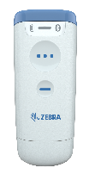
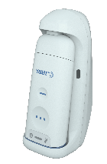
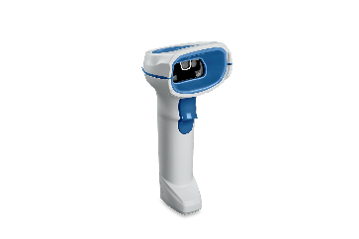
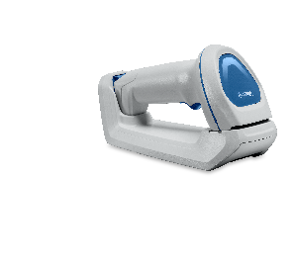
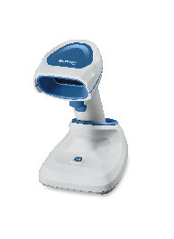
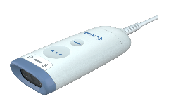
Zebra Healthcare Scanner Portfolio Comparison
Least to Most
Point-of-care |  |  |  |  |  |  |  | Laboratories
Feature | CS60-HC Series |  |  | DS4600-HC Series | DS8100-HC Series |  |  | DS9900-HD Series | Why it Matters
 | CS60-HC Corded | CS60-HC Cordless | CS60-HC Presentation Cradle |  | DS8108-HC | DS8178-HC Standard Cradle | DS8178-HC Presentation Cradle
Disinfectant-ready | Patient-facing | Patient-facing | Patient-facing | Patient-facing | Patient-facing | Patient-facing | Patient-facing | Labs | The CS60-HC, DS4608-HC and DS8100-HC all feature disinfectant-ready housing to help protect against the spread of infection, with the DS8100-HC offering maximum protection with support for the widest range of disinfectants. Note that the DS9900 Series for Labs supports a more limited range of disinfectants.
Supported disinfectants
Purpose-built housing | Yes | Yes | Yes | No | Yes | Yes | Yes | No | The DS8100-HC and CS60-HC offer maximum protection against the spread of infection. Virtually seamless plastics with no speaker holes or exposed screws eliminate areas where bacteria can hide. The CS60-HC has sealed inductive sensing touch buttons.
Mobility |  |  |  |  |  |  |  |  | Designed for nurse carry mobile workflows with iOS, Android, and Windows tablets, smart phones, laptops, and mobile computers.
3

Slide 4
Zebra Healthcare Scanner Portfolio Comparison
NORTH AMERICA
Point-of-care |  |  |  |  |  |  |  | Laboratories
Feature | CS60-HC Series |  |  | DS4608-HC | DS8100-HC Series |  |  | DS9900-HD Series | Why it Matters
 | CS60-HC Corded | CS60-HC Cordless | CS60-HC Presentation Cradle |  | DS8108-HC | DS8178-HC Standard Cradle | DS8178-HC Presentation Cradle
Vibration Feedback with Night Mode | Yes | Yes | Yes | Yes | Yes | Yes | Yes | No | The CS60-HC, DS4608-HC and DS8100-HC support vibration feedback to minimize noise in the patient’s room, admissions desk or lab. With night mode, workers can switch between vibration feedback and beeper feedback in seconds.
Power Precision+ Smart Battery | N/A | No | No | N/A | N/A | Yes | Yes | N/A | Zebra’s PowerPrecision+ battery technology provides a wealth of battery metrics, making it easier to plan battery purchases and maintenance to prevent unplanned downtime caused by battery failures.
Battery Charge/ Health Gauge | N/A | Charge | Charge | N/A | N/A | Charge + Battery Health | Charge + Battery Health | N/A | Clinicians can see with a quick glance at the battery gauge whether a scanner has sufficient charge to get through their shift, preventing workflow interruptions. The gauge blinks when a battery nears the end of its useful life providing advance notice to acquire a new battery.
4

Slide 5
Zebra Healthcare Scanner Portfolio Comparison
NORTH AMERICA
Point-of-care |  |  |  |  |  |  |  | Laboratories
Feature | CS60-HC Series |  |  | DS4608-HC | DS8100-HC Series |  |  | DS9900-HD Series | Why it Matters
 | CS60-HC Corded | CS60-HC Cordless | CS60-HC Presentation Cradle |  | DS8108-HC | DS8178-HC Standard Cradle | DS8178-HC Presentation Cradle
Tool-free Battery Replacement | Yes | Yes | Yes | N/A | N/A | Yes | Yes | N/A | With the CS60-HC and DS8100-HC, clinicians can change the battery in seconds. There’s no need to send a scanner to IT to have the battery replaced with a new or fully charged one.
Illumination Aimer | White / Green | White / Green | White / Green | White / Green | White / Green | White / Green | White / Green | White / Green | The white illumination LEDs on the CS60-HC, DS4600-HC Series, DS9900 Series and DS8100-HC Series can easily read barcodes on color-coded specimen trays and biopsy cassettes.
RFID Option | No | No | No | No | No | No | No | Yes | The DS9900 Series offers RFID for capturing RFID-tagged blood bags and specimens, as well as writing RFID tags in the lab.
5

Slide 6
Zebra Healthcare Scanner Portfolio Comparison
NORTH AMERICA
Point-of-care |  |  |  |  |  |  |  | Laboratories
Feature | CS60-HC Series |  |  | DS4608-HC | DS8100-HC Series |  |  | DS9900-HD Series | Why it Matters
 | CS60-HC Corded | CS60-HC Cordless | CS60-HC Presentation Cradle |  | DS8108-HC | DS8178-HC Standard Cradle | DS8178-HC Presentation Cradle
Driver’s Licensing Parsing | No | No | No | No | No | No | No | Yes | The DS9900 Series offers optional driver’s license parsing* to automatically populate patient admission forms. * North America only
UDI Scan+ Parsing | Yes | Yes | Yes | Coming Soon | Yes | Yes | Yes | Coming Soon | UDI barcode data is automatically parsed, properly formatted and sent in the right order to the right fields in the Electronic Health Record (EHR) or other application, improving efficiency and patient safety.
Lamp Mode | Yes | Yes | Yes | No | No | No | Yes | No | Ideal for point-of-care applications, the built-in lamp can illuminate a nurse’s workspace, so there’s no need to turn on the patient’s room lights at night.
Program-mable second button | Yes | Yes | Yes | No | No | No | Yes | No | The programmable second button lets clinicians instantly toggle between two host applications.
6

Slide 7
Zebra Healthcare Scanner Portfolio Comparison
NORTH AMERICA
Point-of-care |  |  |  |  |  |  |  | Laboratories
Feature | CS60-HC Series |  |  | DS4608-HC | DS8100-HC Series |  |  | DS9900-HD Series | Why it Matters
 | CS60-HC Corded | CS60-HC Cordless | CS60-HC Presentation Cradle |  | DS8108-HC | DS8178-HC Standard Cradle | DS8178-HC Presentation Cradle
Hands-Free Scanning | Yes (in optional stand) | No | Yes | Yes (in optional stand) | Yes (in optional stand) | No | Yes | Yes | Clinicians can quickly scan medications by simply passing them in front of the scanner.
Ability to convert between corded and cordless | Yes | Yes | Yes | No | No | No | No | No | The CS60-HC introduces a first-of-its-kind convertible design that easily converts between corded and cordless operation for superior investment protection.
Swappable PowerCap power option | N/A | No | No | N/A | N/A | Yes | Yes | N/A | The DS8178-HC offers interchangeable power options: a PowerPrecision+ battery or a PowerCap capacitor. Customers can swap power options at any time right in their facility.
7

Slide 8
Thanks

